Slide 1
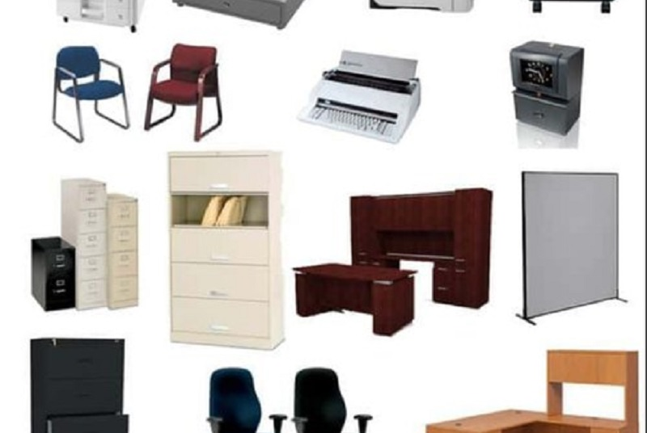
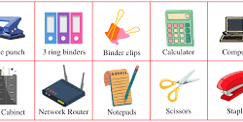
Monitor and control the maintenance of office equipment - 13931

Slide 2
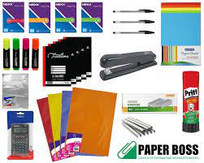
List of Types of Office Equipment
Stationary
Computers
Computers are used for a large amount of office-based tasks. Word processor programs are utilized to type up notes and minutes and to produce reports and communications, while spreadsheet programs will be used in account keeping.

Slide 3
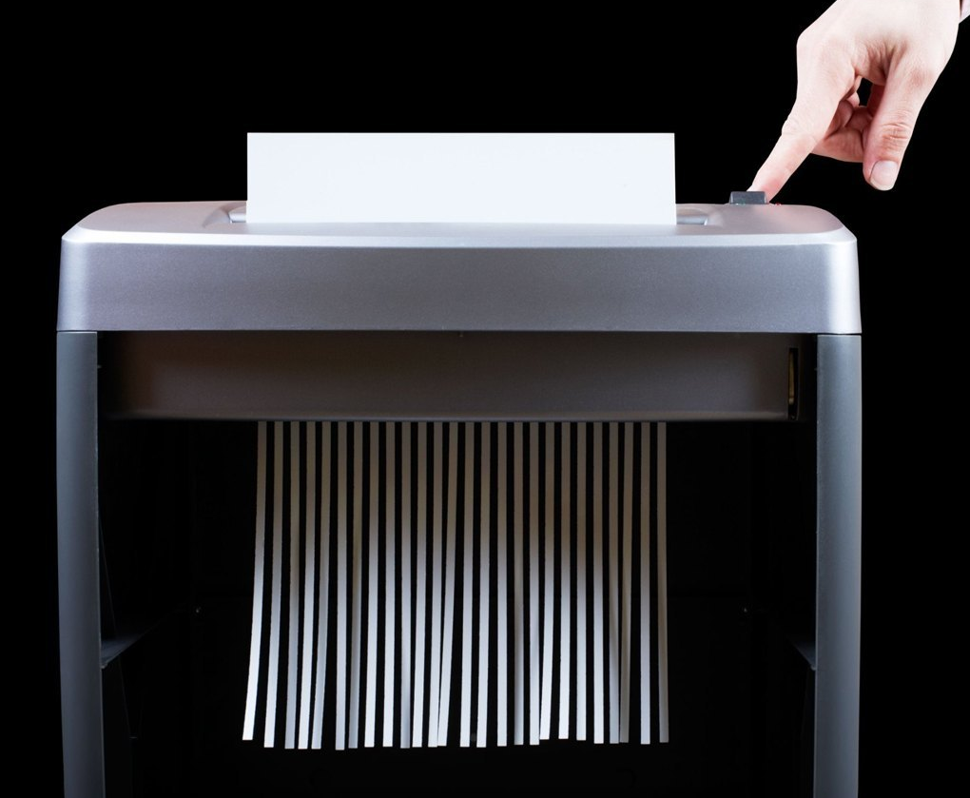
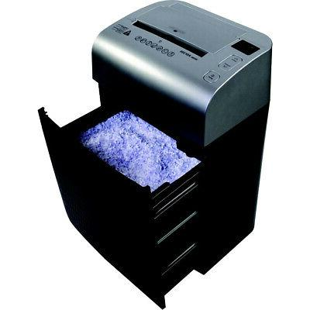
Computer-based Hardware
Several commonly found pieces of office equipment are designed for use alongside computer systems, and are typically connected to them.
Document Manipulation
Other useful machines generally found in offices include the photocopier, which allows workers to make multiple copies of a document for reference and for sharing with colleagues, and shredders. The shredder is increasingly important with the prevalence of identity fraud.

Slide 4
Communications
Professionals need to communicate with individuals both within their company and outside, so most offices will utilize a telephone system. Other functions of phone systems include conferencing, which allows multiple workers to join in the same conversation

Slide 5
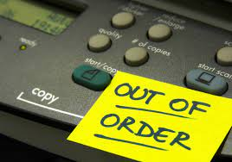
Importance
Each piece of office equipment requires periodic preventative and corrective maintenance over the course of time in order to keep it in working condition. If equipment is broken, employees cannot properly perform their job functions and productivity slows down or even stops.
In exchange for a fixed annual fee, the manufacturer will bear the financial risk and handle the equipment maintenance and repairs.

Slide 6
Your vehicles, without the right fluids and oil, can blow a motor. Without regular cleanings, your saws, nail guns and other equipment will seize up.
Even computers, printers and other related equipment needs proper maintenance to prevent them from crashing.

Slide 7
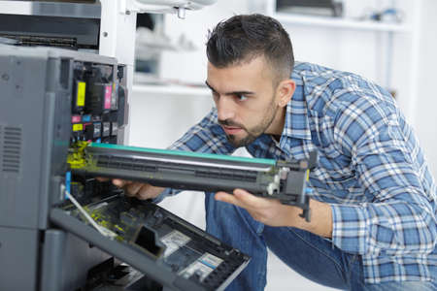
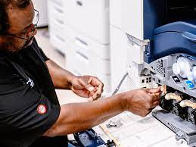
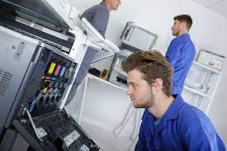
You may think that the time it takes to do routine maintenance lowers productivity.
Not only will this create more downtime, but the costs can be enormous.
There are many software programs that can help you with regular equipment maintenance

Slide 8
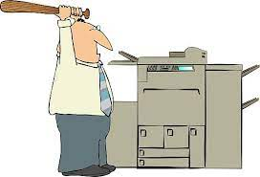
They can help you set up a routine schedule, walk you through the job itself, and in some cases, especially when it comes to computers, have it set up so that the maintenance is done while you are out of the office, automatically.
This means that there really isn't any down time at all. At the end of the scheduled sweep, defragmentation, and disk corrections, a report will appear and you can go over it at your earliest convenience.

Slide 9
If it is too complicated, chances are you aren't going to take the time to learn it, and then it is a waste of money.
The second thing about the software is that is should be quick, easy to use, and does its job in a timely manner.

Slide 10
There should be a lot of different features, especially when it comes to computer cleanup software. The more you are able to have in one software package, the better.
The equipment maintenance software should also make it easy to schedule maintenance, and make it easy to track its history. You should be able to look at these whenever you want, and be able to find it quickly.

Slide 11
Monitor and liaise with maintenance providers
Maintenance procedures typically refer to inspection and repairs of various machines or buildings to ensure there are no problems that might halt production or use.
A maintenance agreement for office equipment is a service contract providing for an outside company to keep your office equipment in good operating condition, or to come in when called to fix a problem with the equipment.
When equipment breaks down, there are costs associated with repairing it.
In exchange for a fixed annual fee, the manufacturer will bear the financial risk and handle the equipment maintenance and repairs.

Slide 12
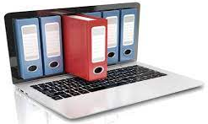
Maintenance agreements cover equipment for a certain time period, which should be clearly identified in the agreement.
Record Keeping System
Organize your preventative maintenance program by implementing a record keeping system. Track equipment failures, part replacements and the frequency of equipment use.

Slide 13
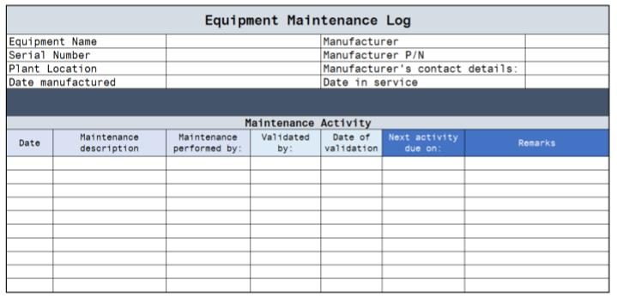
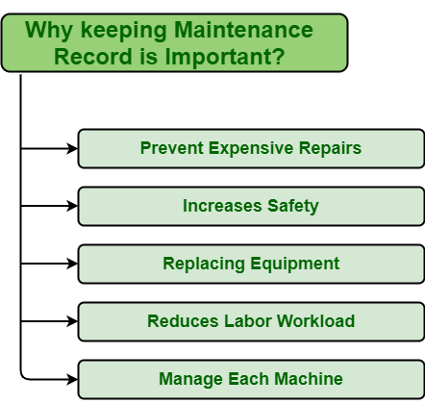
Repair Schedules
Based on the information you've been collecting in your record keeping database, you can devise a schedule for your maintenance program.
However, one person should be in charge of making sure everyone else follows the schedule.

Slide 14
Teamwork
Management should be involved at some level so that the employees know the importance of the preventative maintenance program to the company.

Slide 15
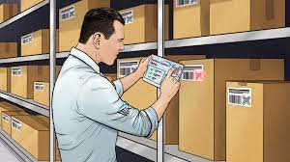
Inventories and lists of supplies
An inventory shows details of all equipment and stores that currently belong to the organisation. Your organisation may have a number of separate inventories, for example, for different sections or locations, or separate inventories for consumables, office equipment and vehicles.
•Who is responsible for restocking supplies?
•Is there a register to track supplies used, or are they freely available?
•Is there a procedure for noting low stock levels?
Lists of supplies can be used to track the use of consumable items, such as stationery and first aid supplies.
There may also be a procedure for using stocks of supplies.

Slide 16
Conduct routine maintenance on designated office equipment
Routine Maintenance is work that is planned and performed on a routine basis
Maintenance types
Generally speaking, there are three types of maintenance in use:
Preventive maintenance, where equipment is maintained before break down occurs.
Corrective maintenance, where equipment is maintained after break down.
Reliability centered maintenance, often known as RCM is a process to ensure that assets continue to do what their users require in their present operating context

Slide 17
3 Types of Maintenance
Preventative maintenance
The act of performing regularly scheduled maintenance activities to help prevent unexpected failures in the future
Corrective maintenance
Trying to restore systems that have broken down
Reliability maintenance
Taking care of items making sure it lasts long

Slide 18
Maintenance
Much of the equipment used in the workplace has regular maintenance requirements, or needs repair at some time, for example:
•to replace consumables or broken parts
•to deal with malfunctions
•to arrange for external servicing or repair
•Is there a designated person responsible for maintaining equipment?
•Is a specialist technician required?
•Will your actions affect the warranty or pose a danger to you or others?
Some problems should be left to the experts. Never try to open the casing of any machinery or electronic equipment, disassemble any equipment components, or interfere with any part of the power supply.

Slide 19
Computers
1.) Keep computers in a dry environment, away from sources of excessive heat or moisture. Do not place a computer next to a heating source or drink your coffee while at the computer.
2.) Wipe screen and keyboard regularly with a static-free cloth and cleaner designed for use on computers.

Slide 20
How to Clean up Computer
3.) Use compressed air to clean debris from between the keys on the keyboard.
4.) Keep ventilation holes on the computer clear of blockages from dust or other items on the desk to prevent overheating.
5.) Plug all computers into surge protectors.

Slide 21
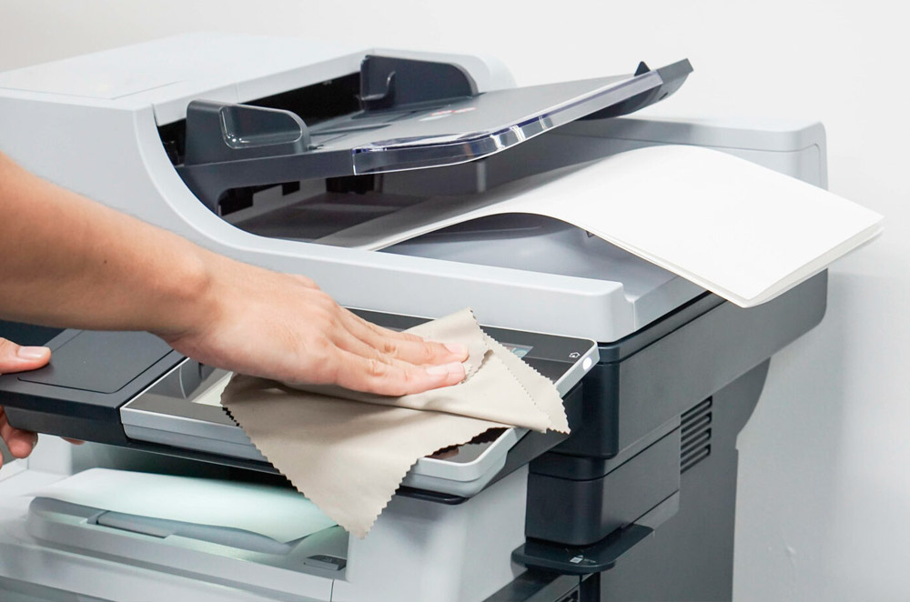
Printers
6.) Open removable parts of the printer and wipe the insides with a dry, clean cloth.
7.) Check the manufacturer specifications on paper weight and size. Verify that the paper you are using does not exceed the recommended weight and size. Paper weight indicates the thickness of the paper and can be found on the manufacturer's packaging.
8.) Do not overfill the paper tray.
9.) Remove all jammed paper completely.
10.) Change ink as needed. Open the top of the printer and remove the ink cartridge.

Slide 22
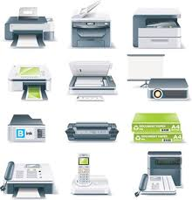
Workplace equipment and machines
Examples of typical office equipment include:
•telephone, fax, photocopiers and pagers
•security systems and intercoms
•television, video and CD players, cameras
•computers, printers, scanners and other peripherals.
There will be specific operational, maintenance and safety requirements for use of this equipment. These are often posted near the equipment, or provided in the manufacturer’s instructions, or during workplace training.

Slide 23
Training
If you do not know how to use a piece of equipment in your organisation, it’s a good idea to ask for training in how to operate it correctly. The training should include instructions for safe use and any related workplace procedures or protocols.
The training should include instructions for safe use and any related workplace procedures or protocols.

Slide 24
If your organisation replaces an existing piece of equipment with a newer model or different brand, you should receive training in operating the new equipment.
Policies, procedures and protocols for accessing training in your workplace could include:
•a requirement to develop a personal training plan
•procedures for requesting training
•approval of costs and time off work to attend training courses
•mandatory training for certain equipment.
If your organisation is very small or in a remote location, you may need to travel to a training venue, complete training online, or have a co-worker teach you.

