Slide 1
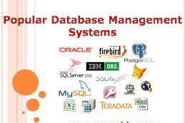
Use a gui based database application to work with simple databases
Unit standard ID: 116936

Slide 2
What is a Database?
A database is a collection of data that is stored in a computer system. Databases allow their users to enter, access, and analyze their data quickly and easily.
Ever waited while a doctor’s receptionist entered your personal information into a computer, or watched a store employee use a computer to see whether an item was in stock? Then you’ve seen a database in action.

Slide 3
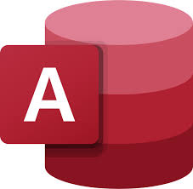
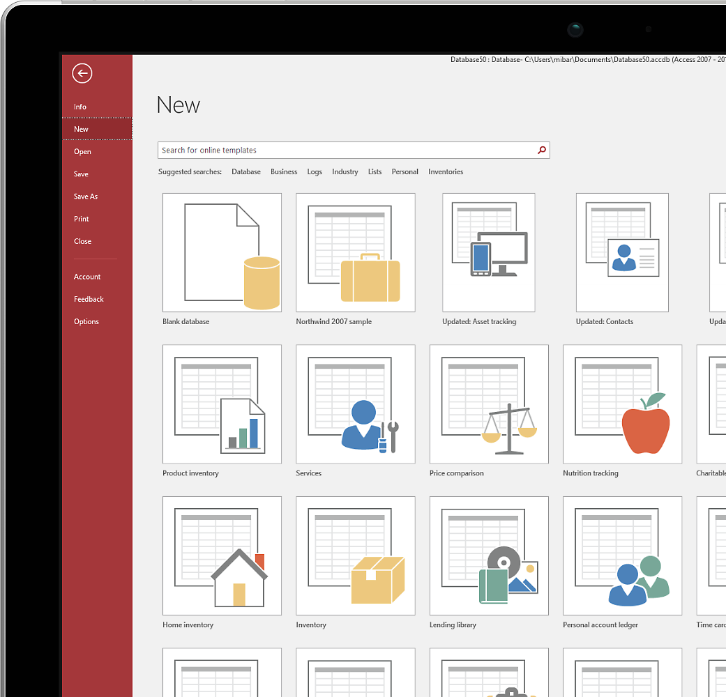
Microsoft Access
You can easily create custom reports and forms to help you make better decisions about your business.

Slide 4
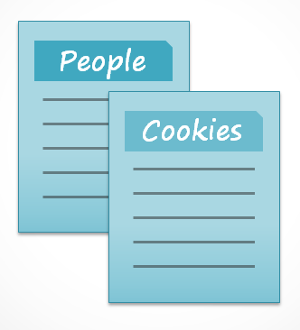
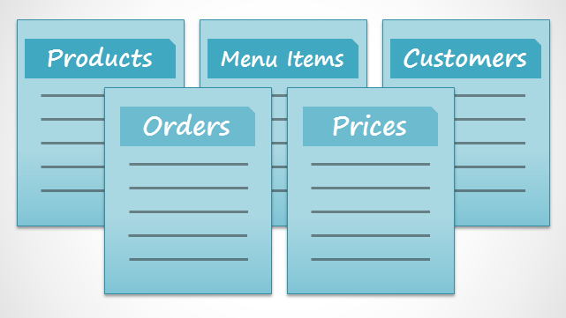
For instance, if you like to bake, you might decide to keep a database containing the types of cookies you know how to make and the friends you give those cookies to.
This is one of the simplest databases imaginable.
It contains two lists: a list of your friends, and a list of cookies.

Slide 5
However, if you were a professional baker, you would have many more lists to keep track of: a list of customers, a list of products sold, a list of prices, a list of orders... it goes on and on
The more lists you add, the more complex the database will be.

Slide 6
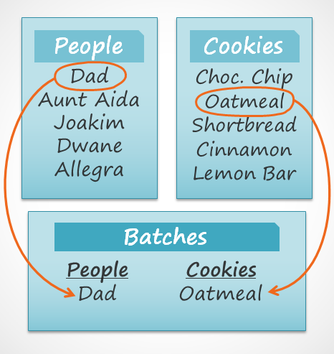
You decide to create a third list to keep track of the batches of cookies you make and who they’re for.
Since you are only making cookies you know the recipe for, and you are only going to give them to your friends, this new list will get all its information from the lists you made earlier.
See how the third list uses words that appeared in the first two lists?
A database is capable of understanding that the "Dad" and "Oatmeal" cookies in the "Batches" list are the same things as the "Dad" and "Oatmeal" in the first two lists.
This relationship seems obvious, and a person would understand it right away. However, an Excel workbook wouldn’t

Slide 7
Excel would treat all of those things as distinct and unrelated pieces of information.
In Excel, you'd have to enter every single piece of information about a person or type of cookie all over again each time you mentioned it, because that database wouldn't be relational like an Access database is.
Simply put, relational databases can recognize what a human can: that if the same words appear in multiple lists, they refer to the same thing.

Slide 8
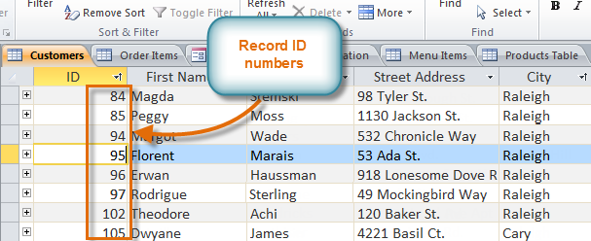
Tables, queries, forms, and reports are the framework for any database you create in Access.
Understanding how each of these objects works will help you create a database that will be useful and will help you retrieve the information you need.
See the number at the left of each row?
That’s the ID number that identifies each record. The ID number for a record refers to every piece of information contained on that row.

Slide 9
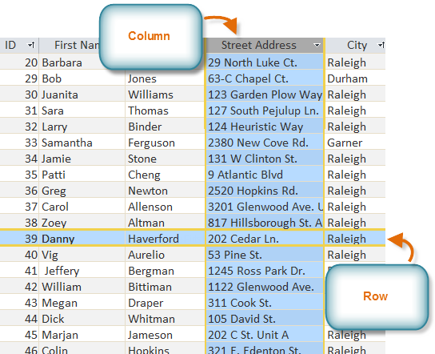
Properties of a database
Tables:
You might already know that tables are organized into vertical columns and horizontal rows.
In Access, rows and columns are referred to as Records and Fields
Likewise, a record is more than just a row; it’s a unit of information.
Every cell in a given row is part of that row’s record.

Slide 10
See the number at the left of each row?
That’s the ID number that identifies each record.
The ID number for a record refers to every piece of information contained on that row.

Slide 11
Since these pieces of information are all details about your customers, you’d include them all in the same table.
Each customer would be represented by a unique record, and each type of information about those customers would be stored in its own field.
If you decided to add any more information-say, the customer's birthday-you would simply create a new field within the same table.

Slide 12
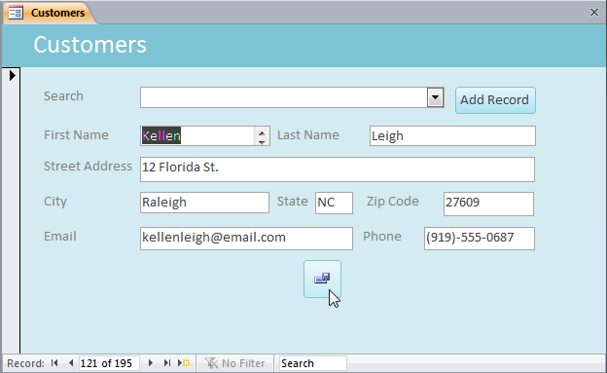
Forms:
You have probably had to fill out forms on many occasions, like when visiting a doctor's office, applying for a job, or registering for school.
The reason forms are used so often is that they're an easy way to guide people into entering data correctly

Slide 13
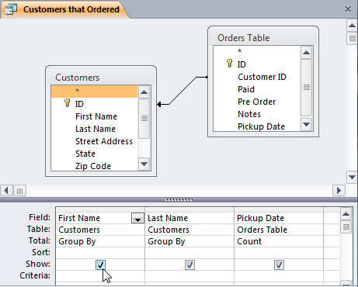
Queries
When you build a query in Access, you are defining specific search conditions to find exactly the data you want.
While a search would be able to help you find the name of one customer at your business, you could run a query to find the name and phone number of every customer who's made a purchase within the past week.
A well-designed query can give information that you might not be able to find out just by looking through the data in your tables.

Slide 14
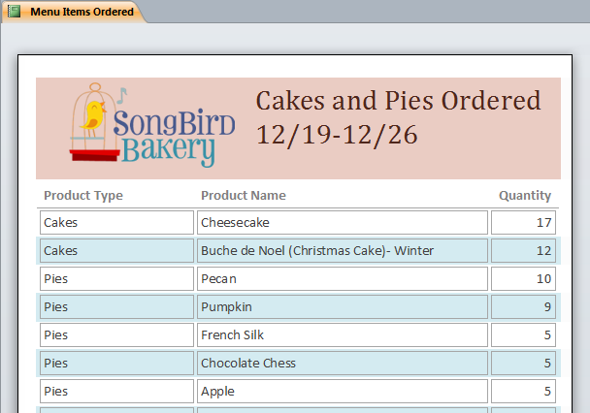
Reports
Reports offer you the ability to present your data in print.
If you've ever received a computer printout of a class schedule or a printed invoice of a purchase, you've seen a database report.
Access offers you the ability to create a report from any table or query.

Slide 15
Think about what is going on around you in everyday situations and whether there might be a database at work.
•Grocery Store: The grocery store is stocked with items. The items have to be ordered, shipped, and stocked in the store. The store has to pay for the items.
•Restaurant: Where does the food come from? How does management know when to reorder a product?
•Traffic Lights: Who or what controls when the lights turn red or green?
A database maintains order and structure in our lives.

Slide 16
Creating a database
When you open Access, Backstage view displays the New tab. The New tab provides several ways that you can create a new database:
•A blank database - This is a good option if you have very specific design requirements or have existing data that you need to accommodate or incorporate.
•A template that is installed with Access - Consider using a template if you are starting a new project and would like a head start.
• A template from Office.com - In addition to the templates that come with Access, you can find many more templates on Office.com.

Slide 17
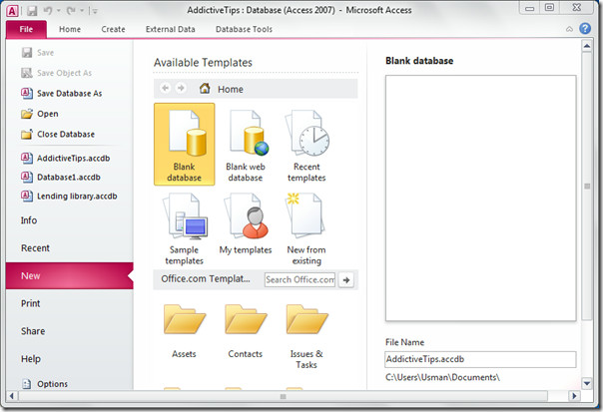

Slide 18
Creating database tables
Access gives you several ways to create tables. There are 3 ways of doing this;
1.) In Datasheet view, you build a table by entering field names and setting data types manually.
2.) Quick start fields are pre-made tables that meet several common business needs. The fields capture data for common business needs, and all field names and data types are set for you.
3.) Design view lets you control every field and property in the table; you'll use it to create a table and to change the values in a lookup field -a field that contains a list of choices.

Slide 19
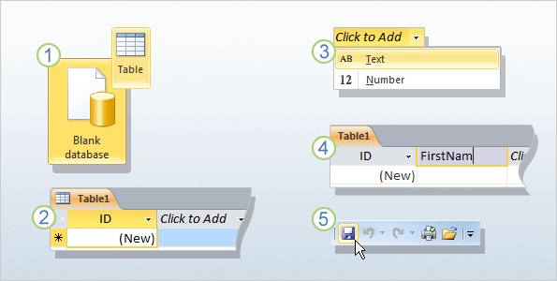
A. Datasheet view
Datasheet view provides a visual way to create a table.
You start by creating a new, blank database or by adding a new table to an existing database.
Either method opens a new table in Datasheet view.

Slide 20
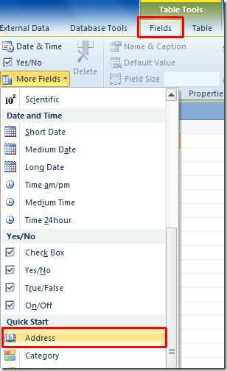
B. Quick start fields
Quick Start fields are a faster way to build parts of a new table
The fields capture data for common business needs, and all field names and data types are set for you.
With a table open in Datasheet view, click the Fields tab, and in the Add & Delete group, click More Fields. A list appears.

Slide 21
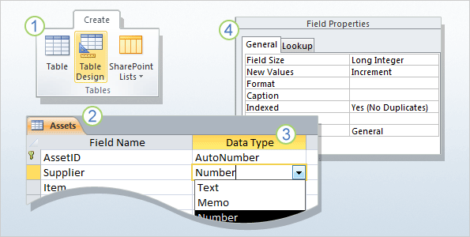
C. Design view
Design view allows you to build a table from scratch and set or change every available property for each field.
You can also open existing tables in Design view and add, remove, or change fields.
On the Create tab, in the Tables group, click Table Design.

Slide 22
Adding and Rearranging Fields
Access makes it easy to rearrange existing fields and add new ones.
When you add a new field, you can even set the data type, which dictates which type of data can be entered into that field.

Slide 23
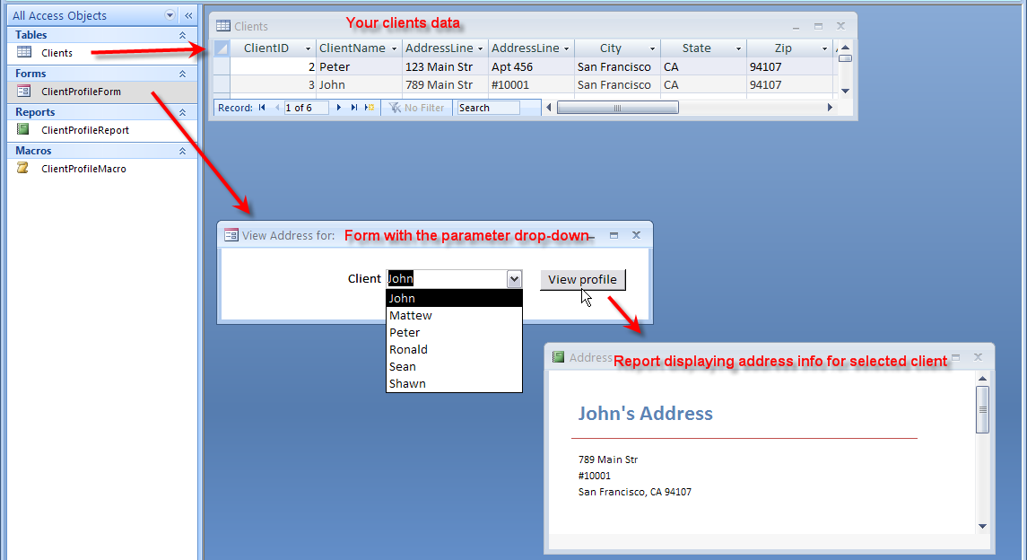
A drop-down menu will appear. Select the data type you'd like for the new field.
•Text: The default option, and best for text. You should also choose it for numbers you don't plan to do math with, like postal codes and phone numbers.

Slide 24
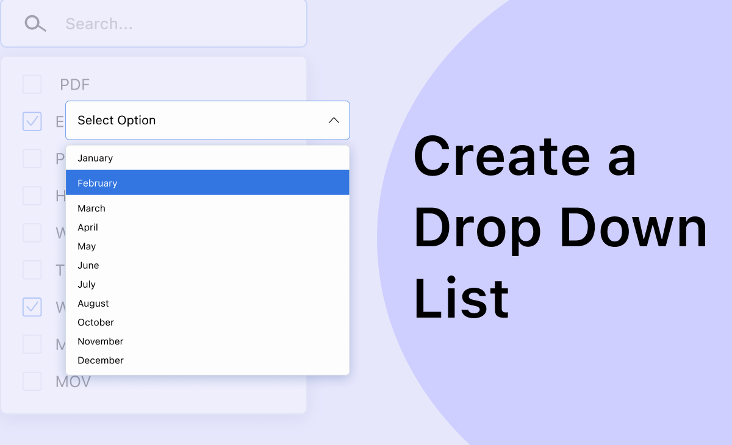
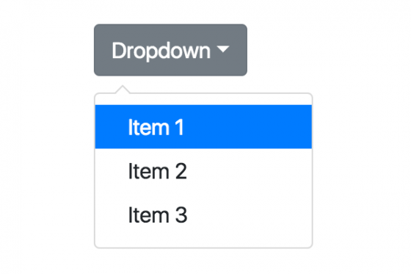
•Number: Best for numbers you might want to do calculations with, like quantities of an item ordered or sold.
•Currency: Automatically formats numbers in the currency used in your region.
•Date & Time: Allows you to choose a date from a pop-out calendar.

Slide 25
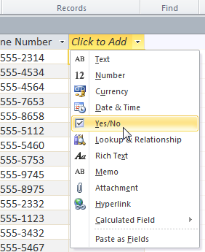
•Yes/No: Inserts a checkbox into your field.
•Memo: Ideal for large amounts of text, like product descriptions. You can format text entered in Memo fields.
•Attachment: Allows you to attach files, like images.
•Hyperlink: Creates a link out of web or email addresses.

Slide 26
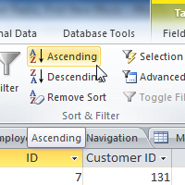
Sorting and searching for records in a table
Access 2010 gives you the ability to work with enormous amounts of data, which means it can be hard to learn anything about your database just by glancing at it.
Sorting and filtering are two tools that let you customize how you organize and view your data making it more convenient to work with.

Slide 27
For example, the information in a database belonging to a bakery could be sorted in a number of ways:
•Orders could be sorted by order date or by the last name of the customers who placed the orders.
•Customers could be sorted by name or by the city or zip code where they live.
•Products could be sorted by name, category (e.g., pies, cakes, cupcakes, etc.), or price.

