Slide 1
Function in a business - 7785

Slide 2
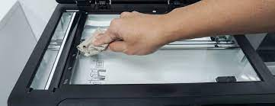
Strategy for maintaining office equipment
In an office workspace the office equipment helps to keep everyone on task and it plays an essential role in keeping an office going as long as they are working in the proper fashion.
The first office equipment that is essential to a workplace is the printer. A printer is good for printing off reports, receipts, forms, and even just about any type of information that might be needed. If problems with the printer arises then it could lead to malfunctions around the office.

Slide 3
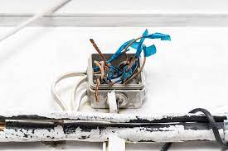
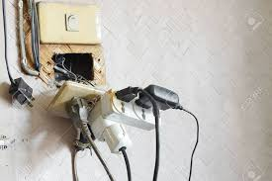
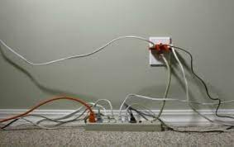
SAFETY PRINCIPLES FOR GENERAL OPERATION OF OFFICE EQUIPMENT
Many people think health and safety principles apply only to factory workers and work environments where heavy equipment is used. But what about the office? It’s a workplace, too. Workplace health and safety issues don’t stop at the office door.
Employees working in office environments may be exposed to many potential hazards, which can be eliminated by following good safety practices to identify and manage the risks.

Slide 4
IMPORTANCE OF UNDERSTANDING THE FUNCTION AND USE OF AN EQUIPMENT
It is important for all personnel in the office to understand the function and use of each office equipment. The following are the reasons;
Minimises time wastages:
Breakdown due to wrong usages:
Injury to the user:
Helps to identify malfunctioning:

Slide 5
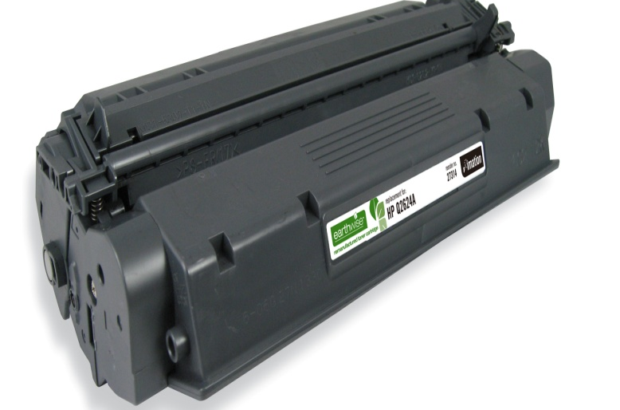
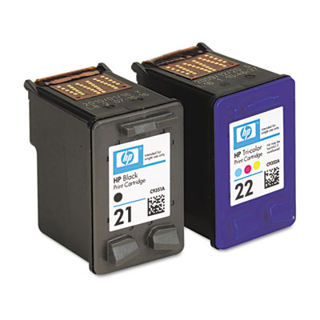
1.4 CONSUMABLES THAT MUST BE REPLENISHED
Most office equipment use consumables in order for them to perform their functions. These consumables must be replenished as they get finished due to continued use. The following is a list of consumables that must be replenished;
1. Toner
3. Computer paper
4. Disks
2. Cartridge

Slide 6
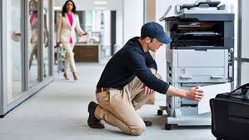
Repairing equipment that is not in good working condition
Whenever an office equipment is not working properly, it must be sent for repair. Most organisations have their own service providers who repair and service their office equipment. Let us look at the process of selecting a maintenance service provider.
1. IDENTIFYING POTENTIAL SERVICE PROVIDERS
2. DRAWING UP A SHORTLIST OF SERVICE PROVIDERS
3. CHOOSING A SERVICE PROVIDER

Slide 7
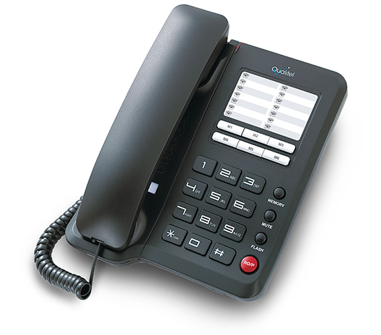
Contacting service providers
1. Email
2. Telephone
3. Letter

Slide 8
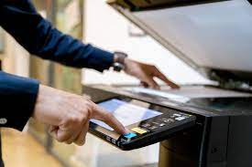
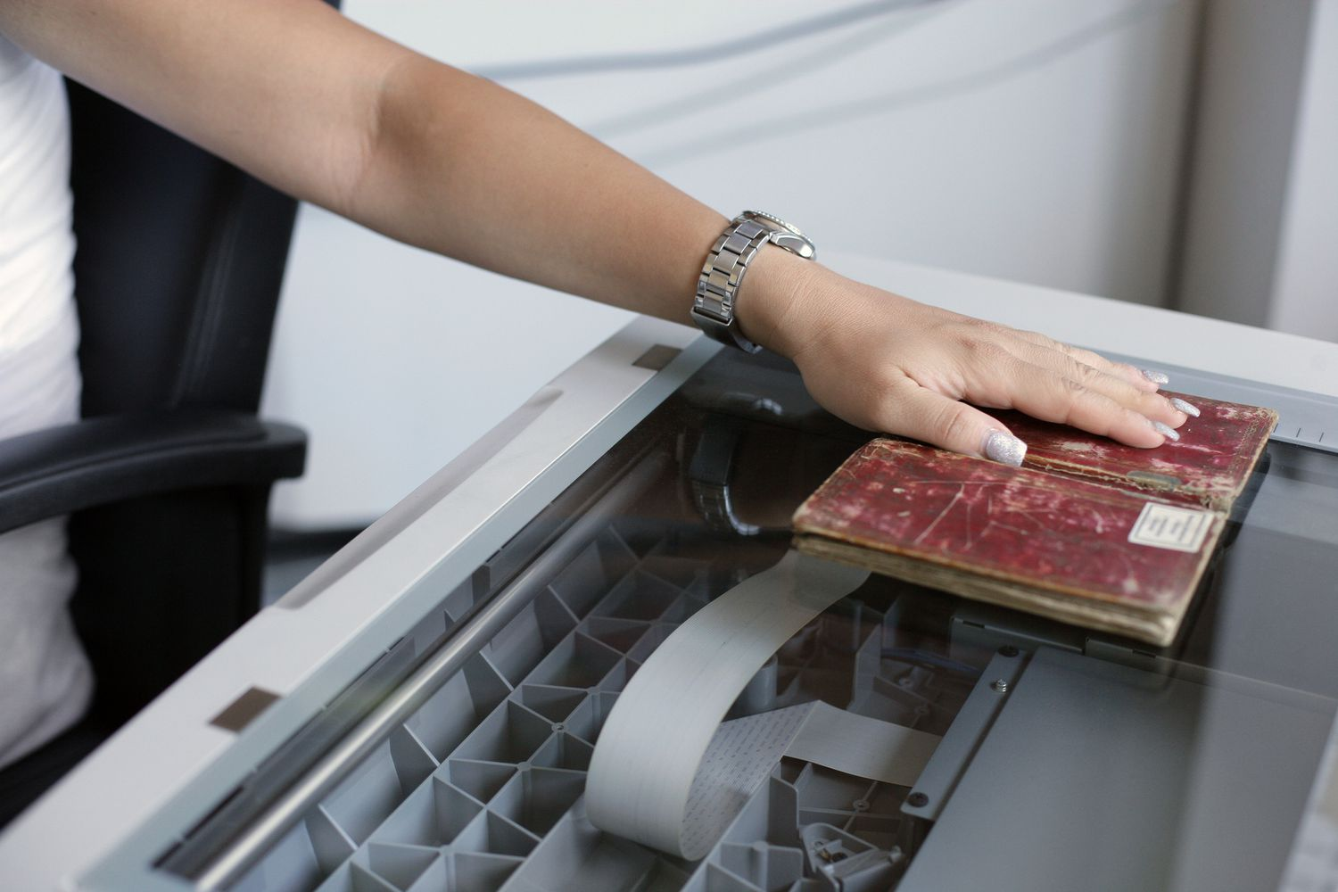
Operating office equipment

Slide 9
Operating office equipment
OPERATING A SWITCHBOARD
1.) This will help you transfer calls faster.
2.) Answer ringing phones by picking up the headset and saying your company's greeting. Some switchboards require you to push the button indicated by the ringing line to answer the phone, particularly if you are already on a separate line.
3.) Call company employees by simply dialing their extensions. Many switchboards, however, require you to dial a number before calling out, such as "9." Consult your switchboard manual or another employee about how to dial out.
4.) Place the call on hold by pressing the "Hold" button, if necessary. Retrieve the call by pressing the "Hold" button for a second time. While calls are on hold you can complete internal or external phone calls, answer other ringing lines or address face-to-face customers.

Slide 10
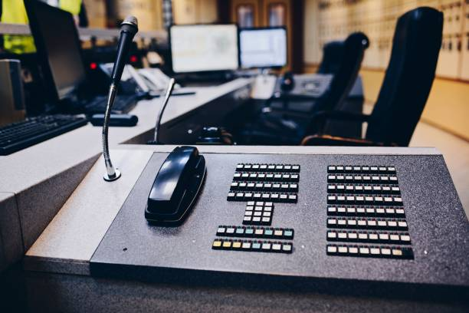
5.) Transfer a call by pressing the "Transfer" button, then waiting to hear a dial tone. Dial the extension of the person to whom you are transferring the call, then press "Transfer" again. Press the "Release" button to transfer the call, or just hang up the phone.
6.) Start a conference call by answering an incoming call or dialing a number. Press the "Conference" button, then wait for a dial tone. Dial the number or extension of the person receiving the conference call. Once she answers, alert her of the conference call, then press the "Conference" button again to connect the parties.

Slide 11
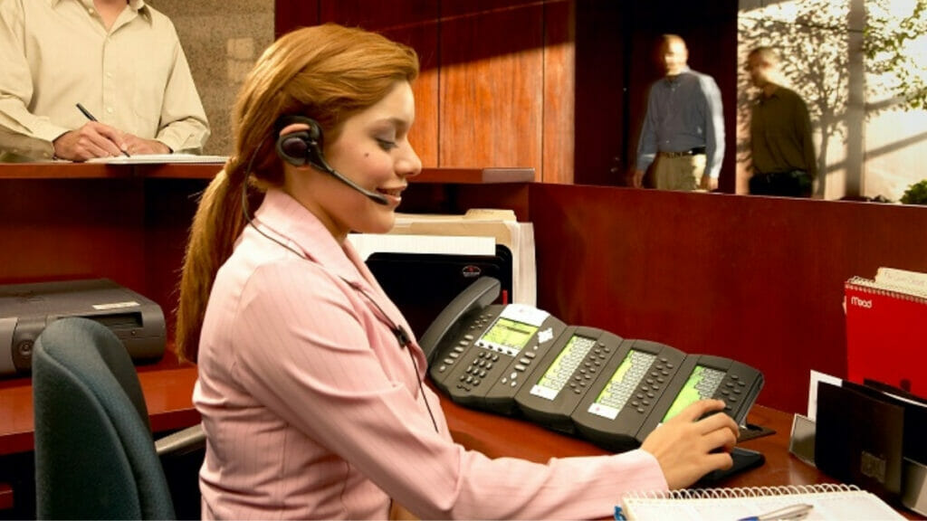
7.) Place a call on speakerphone by pushing down on the "Speaker" button. Take a call off of speakerphone by pressing down on "Speaker" again.
8.) Consult your switchboard manual for additional information about the specifics of your switchboard system.

Slide 12
Once an employee has been recruited, he or she must complete certain work responsibilities in line with the organisations’ procedures and policies.
Work responsibility refers to duties that people in certain positions should claim.
Sensitivity to people – Diversity
The world's increasing globalization requires more interaction among people from diverse cultures, beliefs, and backgrounds than ever before.

Slide 13
We can all work together more effectively by following these four easy steps:
1.) Understand and respect individual differences
2.) Be assertive
3.) Learn how others want you to treat them
4.) Act as a force for change

Slide 14
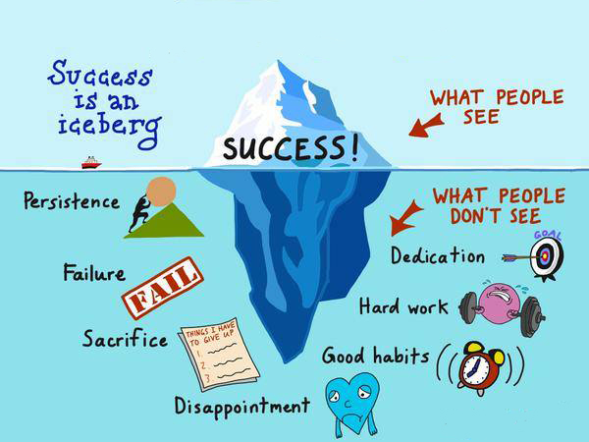
Showing sensitivity
Before you judge them, step into their shoes
Think about how you'd feel if you were treated the way you may treat this other person
Don't let one encounter ruin your perception of that person
When you talk to them, don't let your insecurities or beliefs get in the way

Slide 15
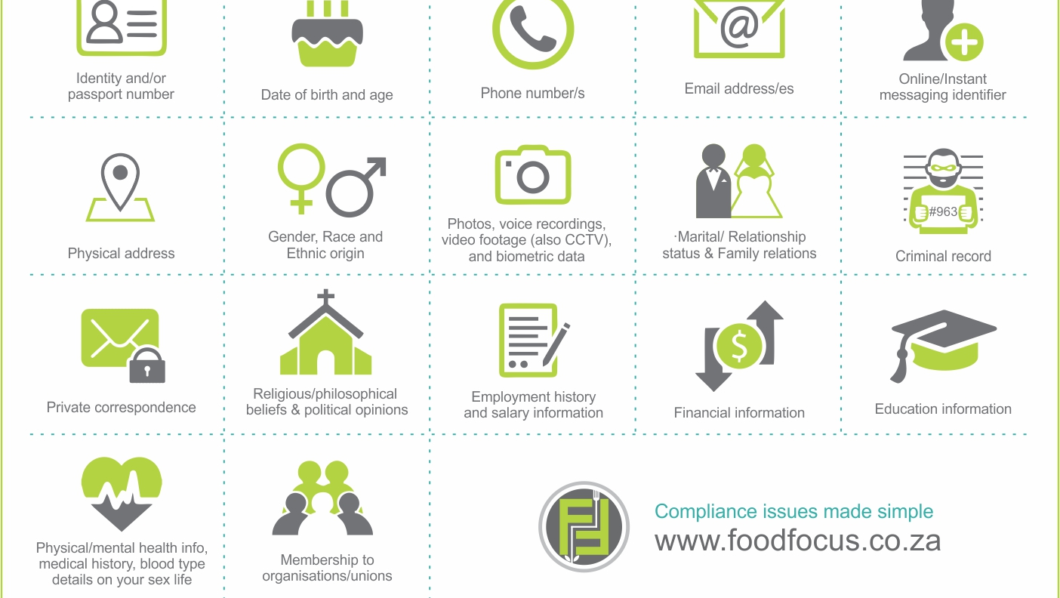
POPI Act

Slide 16
Scope of responsibility
Every employee must know the scope or extend of their responsibilities in the organisation. Job descriptions are written statements that describe the:
duties,
responsibilities,
most important contributions and outcomes needed from a position,
required qualifications of candidates, and
Reporting relationship and coworkers of a particular job.

Slide 17
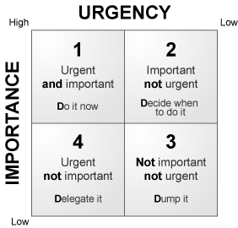
Work prioritisation
The Urgent/Important Matrix is a powerful way of thinking about priorities. Using it helps one to overcome the natural tendency to focus on urgent activities, so that one can keep clear enough time to focus on what's really important. Figure below shows the time management matrix.

Slide 18
Quadrant 1 – Urgent & Important, this quadrant refers to critical emergencies, crises, last-minute deadlines that arrive because of unforeseen circumstances and lack of attention to important things before they turn critical. Perform these duties now.
Quadrant 2 – Not Urgent but Important, this quadrant refers to regular activity needed to achieve future goals but also prevent disasters from showing up in Quadrant 1. Plan to do these tasks next.

Slide 19
Quadrant 3 – Urgent but Not Important, this quadrant refers to interruptions and distractions throughout the day that take our attention away from more important matters. Postpone these chores.
Quadrant 4 – Not Urgent and Not Important, this quadrant refers to absolute time-wasting activities that do little to achieve goals or address important matters at hand. Avoid these distractions altogether

Slide 20
Filing
If a job or task involves paperwork, filing must be done. Filing means keeping documents in a safe place and being able to find them easily and quickly. Documents that are cared for will not easily tear, get lost or dirty.
What do we file?
We file documents that are sent to us by other people or organisations. We also file records of all our organisational activities. These can be letters, memos, reports, financial records, policy documents, etc.
When do we file?
This depends on how busy your office is. In very busy organisations filing is done at least every day and usually first thing in the morning. In a small or less busy office you could file once or twice a week.

Slide 21
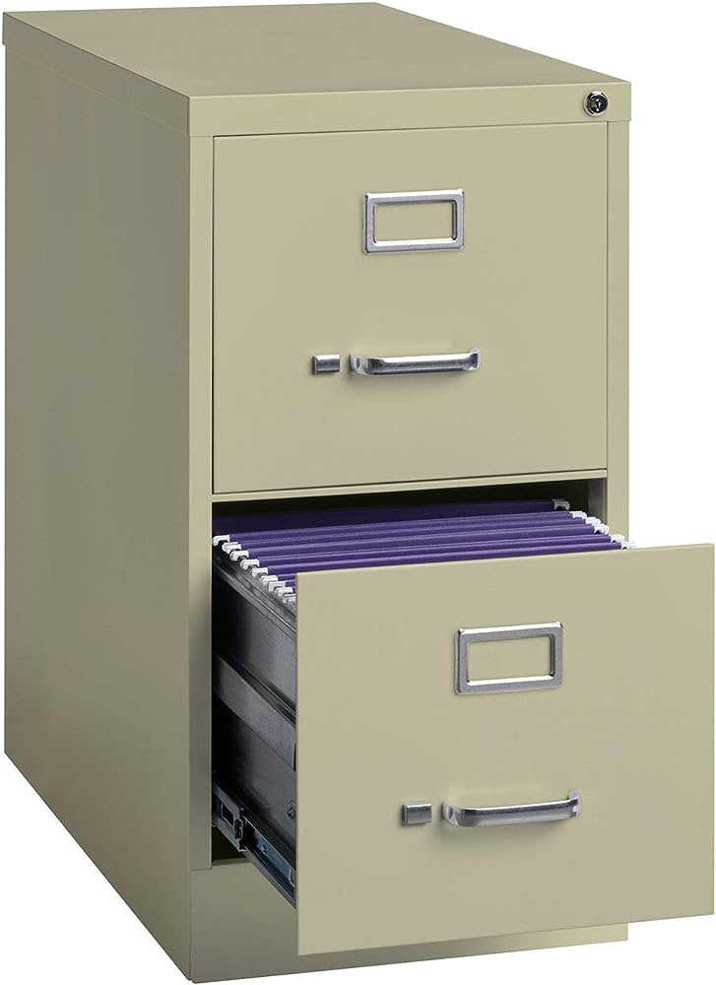
Equipment used for filing
Filing Cabinet - It is used to keep flat files and suspension or hanging files Steel Cabinet - It is used to keep big files that need to be locked up Date Stamp - It is used to date stamp documents that are received on daily basis so that they are filed in chronological order and so we have a record of when we received the document Register - It is used to record files taken out and files returned Filing shelves - It is used to file box files Box file - This is a big file that is used to keep big documents that cannot go into a filing cabinet. They are kept in shelves.

Slide 22
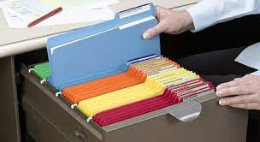
Methods of filing
There are 5 methods of filing:
Filing by Subject/Category
Filing in Alphabetical order
Filing by Numbers/Numerical order
Filing by Places/Geographical order
Filing by Dates/Chronological order
There are two basic rules underlying filing:
ALPHABETICAL FILING - filing according to the letter of the alphabet DATE FILING - most recent files on top

Slide 23
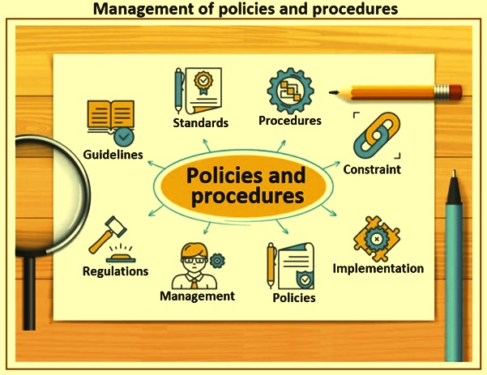
Deviation from organisational procedures

Slide 24
There are certain instances where, an employee can deviate with the organisational procedures and go unpunished.
For safety purposes. In an emergency situation, an employee can deviate from a procedure in order to save the equipment, his life or that of other people. For example, during a fire caused by electrical fault the office administrator switches the printer from the plugs. In the procedure, the printer must be switched off first before switching off the plug.
Procedures are not available. A worker can deviate from a procedure if the procedures have not been made available by the superior.
Procedures are not correct or out of date.

