Slide 1
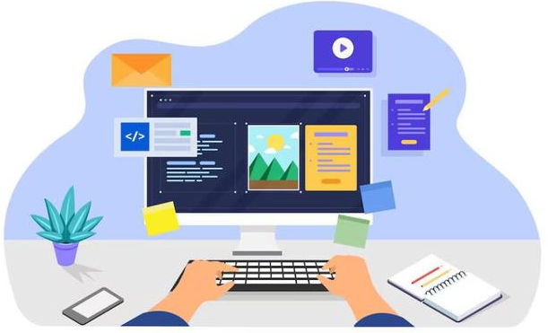
Introduction to Computers - 117925

Slide 2
A computer is an electronic device that manipulates information or "data." It has the ability to store, retrieve, and process data. You can use a computer to type documents, send email, and surf the Internet. You can also use it to handle spreadsheets, accounting, database management, presentations, games, and more. Whether you realize it or not, computers play an important role in our lives. When you withdraw cash from an ATM, scan groceries at the store, or use a calculator, you're using a type of computer

Slide 3
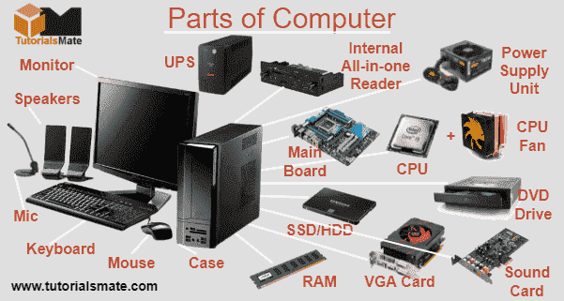
All types of computers consist of two basic parts – hardware and software. Hardware is any part of your computer that has a physical structure, such as the computer monitor or keyboard. If you can touch it, it is hardware. Software is any set of instructions that tells the hardware what to do
What are the Different Types of Computers?
personal computers such as desktop and laptop

Slide 4
What is an operating system?
An operating system is the most important software that runs on a computer. You might be thinking, “OK, but what is software?” Software is any set of instructions that performs some task on a computer. The operating system performs many essential tasks for your computer.
You've probably heard the phrase boot your computer, but do you know what that means? Booting is the process that occurs when you press the power button to turn your computer on. At the end of at process, the operating system loads. From this point, the operating system begins to do its job of controlling the way in which the computer functions. The operating system is responsible for managing the computer's hardware and software resources. Basically, the operating system serves as the boss, or manager, and makes sure all the various parts of the computer get what they need.

Slide 5
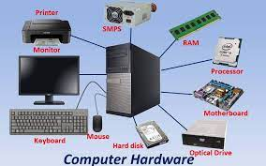
When you use your personal computer, you may work on a Word document, print an email, and have your Internet browser open for web surfing, all at the same time.
These three programs need attention from the central processing unit (CPU) to do whatever task that you, the user, are telling it to do. These programs need memory and storage, and need to be able to send messages to devices such as the mouse and the printer to accomplish these tasks.

Slide 6
Types of Operating Systems
The three most common operating systems for personal computers are Microsoft Windows, Apple Mac OS X, and Linux.
Apple Mac OS
Mac OS is a line of operating systems created by Apple Inc. The Mac operating system is proprietary software that comes preloaded on all new Macintosh computers, or Macs.
Microsoft Windows
Microsoft created the operating system, Windows, in the mid-1980s. They have a version of the operating system that is designed for the home user, and a professional version, which is intended for businesses. The versions differ in the depth of networking, security, and multimedia support.
Linux
Linux is an open source, or free, operating system. Unlike Windows and Mac OS, Linux is not proprietary software and all the computer code that is part of the operating system can be used and modified by any user

Slide 7
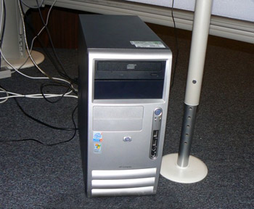
What are the basic parts of a desktop computer?
All of the basic parts of a desktop computer are considered hardware. The computer case, monitor, keyboard, mouse, and power cord are considered the basic parts. These items are the things you notice right away when you look at a desktop computer
The computer case is the metal and plastic box that contains the main components of the computer. It houses the motherboard, central processing unit (CPU), the power supply, and more.
Basic Parts of a Desktop Computer

Slide 8
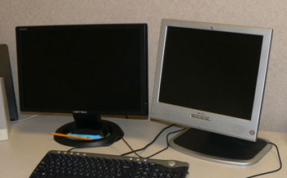
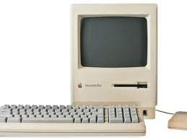
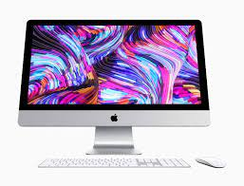
The monitor works with a video card, located inside the computer case, to display images and text on the screen. The two main types are cathode ray tube (CRT) and liquid crystal display (LCD) monitors. The CRT monitor is big, like a tube television, and takes up a lot of desk space; however, it is the least expensive monitor option. The LCD monitor is thin and saves energy, but costs more.

Slide 9
Your monitor has an on/off button and control buttons that allow you to change your monitor's display.
Power Cord The power cord is the link between the power outlet and the power supply unit in the computer casing. If the power cord is not plugged in, the computer will not power on
The keyboard is a piece of hardware that resembles a typewriter keyboard
The main part of a computer keyboard has alpha-numeric (letter and number) keys
The Escape key, labeled Esc, allows you to stop a function or action. For example, if your computer suddenly freezes up, you may be able to resume by pressing Es
The Function keys, along the top of the keyboard, are labeled F1, F2, up to F12

Slide 10
The Print Screen, Scroll Lock and Pause/Break keys are at the far right end of the keyboard.
The Control (Ctrl), Alternate (Alt), and Shift keys are designed to work with other keys. For example, if you press Ctrl + S at the same time, you can save a file.
The Backspace key erases the character to the left of the cursor
iMac USB Keyboard
To the right of the regular keys is the cursor control pad. At the bottom are four arrow keys. Pressing any one of these keys moves the cursor in the direction of the arrow. Depending on the keyboard you are using, there are five to six keys above the arrows including:

Slide 11
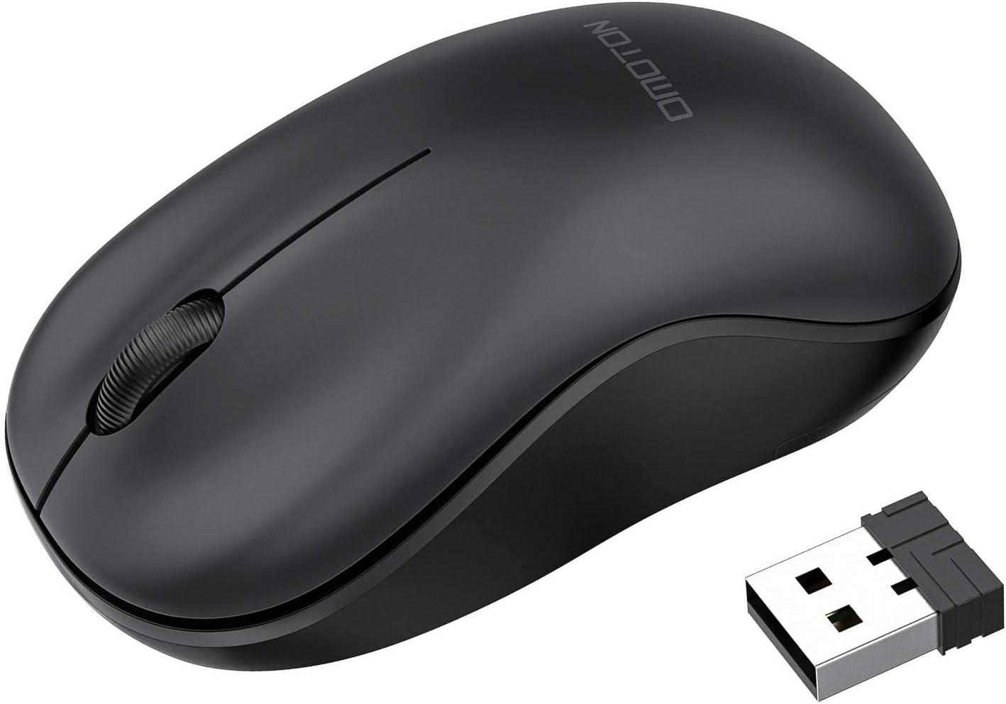
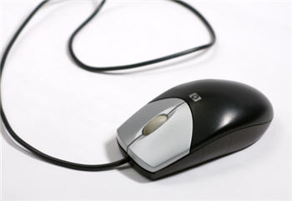
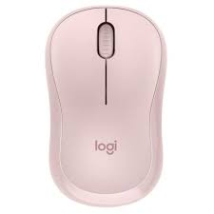
There are two main types of mice -- optical and mechanical. The optical mouse uses an electronic eye to detect movement and is easier to clean.
The mechanical mouse uses a rolling ball to detect movement and is more difficult to clean; however, it is less expensive, so many computers come with a mechanical mouse.

Slide 12
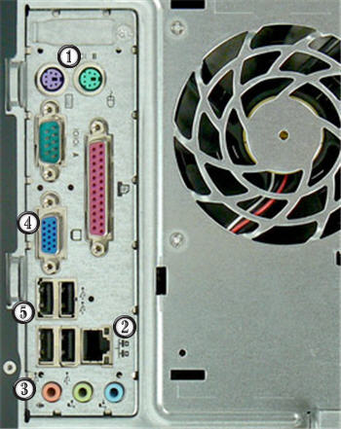
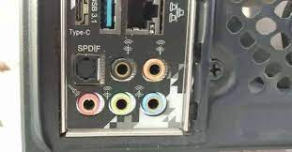
Back of Computer Case
PS/2 Port These ports are called PS/2 ports and are used for the mouse and keyboard. Many people refer to them as the mouse port or the keyboard port.
Ethernet Port This port looks a lot like the modem or telephone port but it is actually wider. You can use this port for networking and also connecting to the Internet. Ethernet

Slide 13
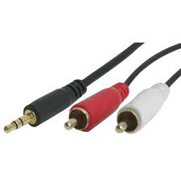
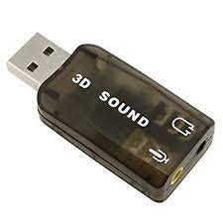
Audio In/Audio Out Every computer has a bank of audio ports where you can connect various devices, including speakers, microphones, headsets, and more.Audio
VGA Port Your monitor can is connected to this port.
USB Port The Universal Serial Bus port is one of the newest ports, but is also one of the most useful. These USB ports let you attach a variety of devices such as mice, printers, keyboards, web cameras, USB/flash drives, and digital cameras to your computer quickly

Slide 14
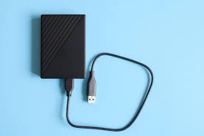
Hard Disk Drive Hard Disk Drive
The hard disk drive is the data center of the computer. All of your programs are stored here. The hard disk drive is long-term storage where information is stored permanently. When you use a word processing program, the computer loads the instructions from long-term storage (your hard disk) into short-term memory. Hard disk speed determines how fast your computer starts up and loads programs. The hard disk is called the C drive on most computers.

Slide 15
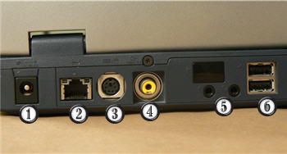
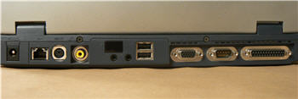
Laptop Buttons, Drives, and Ports
Back of Laptop Labelled
Power Cord Connector This is where you connect your AC power adapter.
Ethernet Port This port looks a lot like the modem or telephone port but it is actually wider. You can use this port for networking and also connecting to the Internet.
PS/2 Port This port is the mouse and keyboard port.

Slide 16
Keep Your Computer Safe
Cleaning your computer and doing preventive maintenance, such as scanning for viruses, helps keep it running smoothly. Preventative maintenance saves you time, as well, since it saves you the hassle of dealing with systems failures and data loss.
Viruses, Trojan Horses, and Worms
Viruses Just like a biological virus can make you physically sick, a computer virus can make your computer sick. A virus is a small piece of software that finds it way onto your computer without your knowledge, and causes trouble on your computer system. You may not even know your computer has been infected with a virus until your computer slows down, a program stops working, your computer crashes, or error messages begin appearing.

Slide 17
Many viruses are transferred by email. The virus will travel as an email attachment, and when the attached file is downloaded, the virus will begin to do its job. Often, email viruses will continue to spread by attacking your address book, emailing your contacts, and spreading the virus more.
Tips to Stay Safe
Use Anti-virus Software The best thing you can do for your computer is use an anti-virus software. Anti-virus software is a program that protects your email, files, and downloads against viruses, worms, and Trojan horses; removes existing threats from your computer; and protects against new viruses if the anti-virus software is updated regularly.
There are several free options, or you can purchase a commercial one such as Norton or McAfee, which
Be Cautious of Email Attachments Never double-click on an email attachment that contains an executable file with an extension such as .exe or .vbs. In generally, be cautious of email attachments and don't download or open files from people you do not know or were not expecting to receive an email from.

Slide 18
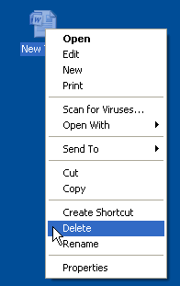
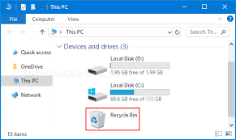
Emptying the Recycle Bin
When you delete a file from your computer, or move it to the Recycle Bin, it is not automatically deleted, but rather is temporarily stored in the Recycle Bin. This usually gives you the chance to restore the file if you decide you do not want to delete it. If you want to permanently remove files from the computer, thereby clearing the hard disk space the file is located, you need to permanently delete the files in the Recycle Bin. You can do this by emptying the entire Recycle Bin, or deleting individual files.

Slide 19
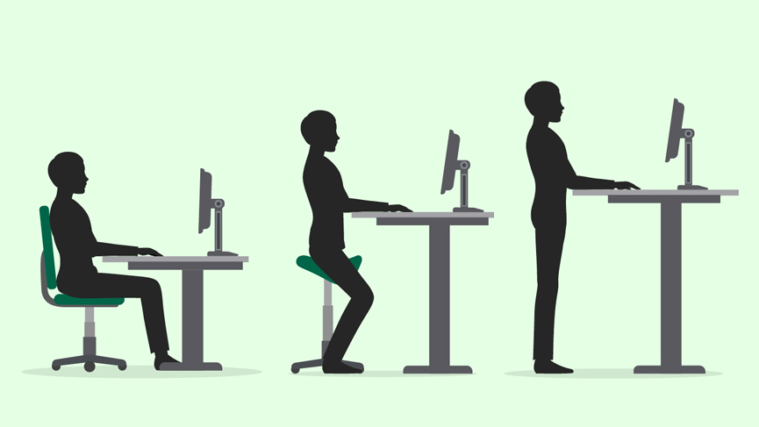
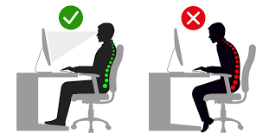
-Health, Safety and Environment
Ergonomics
Understand what elements and practices can help create a good working environment such as: appropriate positioning of monitors, keyboards and adjustable chairs, use of a mouse mat, use of a monitor filter, provision of adequate lighting and ventilation, frequent breaks away from the computer.
Ergonomics is the science of co-ordination the physical and psychological aspects of human beings with their working environment. Although computers present us with great opportunities for making our work easier, they do present some health and safety risks if used incorrectly. The science of ergonomics tells us how to use computers correctly.

Slide 20
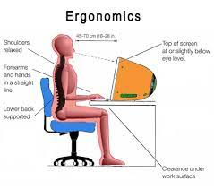
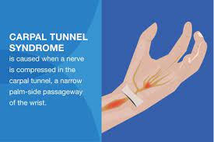

Slide 21
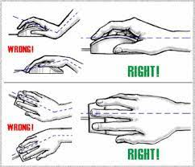
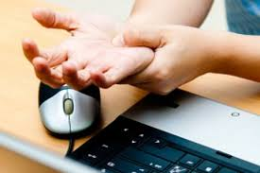
Monitors
If you work with a monitor, tired, sore or blood-shot eyes indicate eye strain.
Keyboards and mouse
Repeated use of the same muscles and joints can result in a type of injury called RSI or
Repetitive Strain Injury. This type of injury can range from inflammation of joints, to damaged ligaments and muscles or even hairline fractures in bones. RSI is usually caused by the incorrect use of the keyboard and mouse.

Slide 22
Information Security
Because information and information technology are fundamental to just about all aspects of modern life, the modern era is often referred to as the Information age. By its very nature, much information is private and confidential. Information security refers to all the procedures which are used to protect information for deliberate or accidental misuse or dissemination. Technically, it refers to the maintenance of the integrity of information. Integrity means that the information remains correct at all times and cannot be accessed by unauthorised agents.
Personal privacy
If personal information such as health or finance status, personal or family issues and background details became available to unauthorised agents, this could lead to the standing of individuals being seriously compromised. In some cases it may have little more effect than a feeling of invasion of personal privacy, while in other cases in may lead to serious embarrassment, loss of status or job and even blackmail.

Slide 23
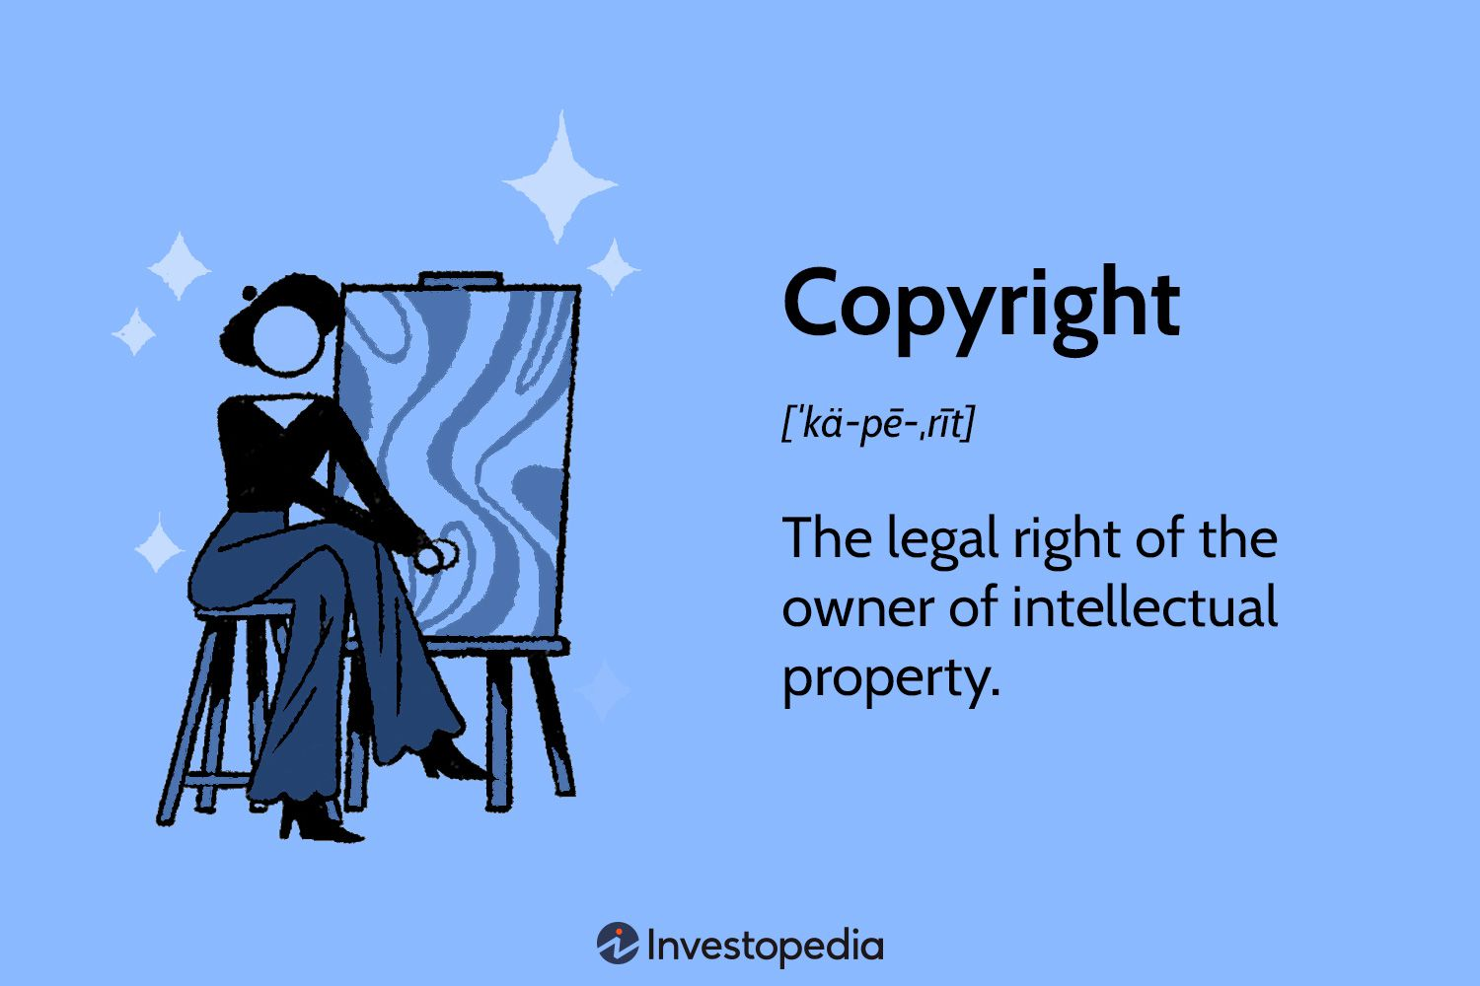
Copyright and the Law
Copyright
Understand the concept of copyright when applied to software, and also to files such as: graphics, text, audio, video. Understand copyright issues involved in downloading information from the Internet.
Copyright
Copyright refers to the legally protected right to publish and distribute any literary, musical, artistic or software material. This means that only the developer and authorised sellers have the right to copy and distribute computer software, video materials, music or text.

Slide 24
Because there is no control over the Internet, there are hundreds of sites where software, music and videos can be downloaded. Access to permanent connections makes downloading of large files physically possible. Many of these sites are located in countries that do not protect copyright.
The fact that it is possible to do something does not make it legally and ethically right. Authors and developers are entitled to a return on their creative efforts.

Slide 25
Downloading pirated material is both ethically and legally wrong.
By reducing revenue, piracy can hamper the development of software.
Software development is expensive and part of the royalties are needed for future development.
Software piracy is a form of theft. It is both a criminal and a civil offence. Developers are entitled to claim damages in cases of piracy.
Increasingly they are making use of all legal avenues to reduce piracy and obtain compensation where it has occurred.

Slide 26
Quiz assistance
1.) Pg.15
2.) Pg.19
3.) Pg.19
4.) Pg.21
5.) Pg.22
6.) Pg.15
7.) Pg.26
8.) Pg.26
9.) Pg.27
10.) Pg.28
11.) Pg.28
12.) Pg.32
13.) Pg.32
14.) Pg.30

