Slide 1
Apply basic invoicing and accounting principles
252435 / 11241

Slide 2
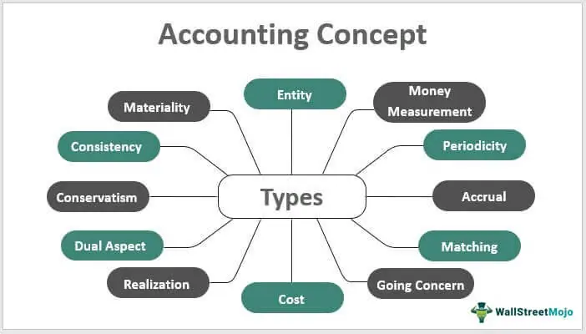
In all activities (whether business activities or non-business activities) accounting is required to account for these resources.
In other words, wherever money is involved, accounting is required to account for it.
Accounting is often called the language of business.
Accounting, as an information system is the process of identifying, measuring and communicating the economic information of an organisation to its users who need the information for decision making

Slide 3
Objective of accounting
1.) To keep systematic record: It is very difficult to remember all the business transactions that take place.
2.) To ascertain the results of the operation
3.) To ascertain the financial position of the business
4.) To portray the liquidity position: Financial reporting should provide information about how an enterprise obtains and spends cash
Liquidity is a measure of how easily an asset can be exchanged
Cash on stocks usually have high liquidity, because they are easy to access and trade
A commodity is a tangible good that can be bought and sold or exchanged for products of similar value
Commodity

Slide 4
5.) To protect business properties: Accounting provides up to date information about the various assets that the firm possesses and the liabilities the firm owes
6.) To facilitate rational decision-making
7.) To satisfy the requirements of law Income Tax Act, Paying VAT

Slide 5
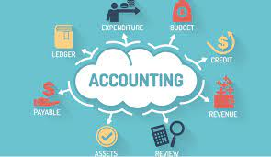
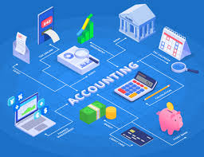
Business transactions
In a simple statement, transaction means the exchange of money or money’s worth from one account to another account.

Slide 6
The concept of expenditure
Expenditure is defined as the costs that have been incurred within a specified financial period of a business
For the accounting purpose expenditures are classified in three types:
I.) Capital Expenditure is an amount incurred for acquiring the long term assets such as land, building, equipments which are continually used for the purpose of earning revenue.
Necessary
Comfortable
Luxury
Food; clothes
Fast foods, more than 1 car
Designer clothes; Lamborghini

Slide 7
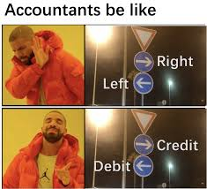
For the accounting purpose expenditures are classified in three types:
II.) Revenue Expenditure is the expenditure incurred in one accounting year and the benefits from which is also enjoyed in the same period only.
III.) Deferred Revenue Expenditure is a revenue expenditure which has been incurred during an accounting year but the benefit of which may be extended to a number of years.

Slide 8
Concept of revenue
In business, revenue or turnover is income that a company receives from its normal business activities, usually from the sale of goods and services to customers.
Revenue may refer to business income in general, or it may refer to the amount, in a monetary unit, received during a period of time, as in "Last year, Company X had revenue of R62 million.

Slide 9
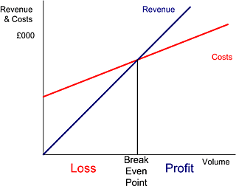
1.) Where the Revenue line and the cost line meet, the business does not make a profit or loss and is said to be at the breakeven point.
2.) To the left of the breakeven point, the business is making a loss because costs are greater than revenue.
3.) To the right of the breakeven point, the business is making a profit because revenue is greater than costs.

Slide 10
PROFIT = REVENUE - COST
A shopkeeper buys scientific calculators in bulk for R15 each. He sells them for R40 each. Calculate the profit on each calculator in Rands, and as a percentage of the cost price.
Given: cost price = R15, selling price = R40
Profit = selling price - cost price
= R40 - R15
= R25

Slide 11
Fixed costs
In other words, even if the business has a zero output or high output, the level of fixed costs will remain broadly the same.
Variable costs
Variable costs are those costs which vary directly with the level of output.

Slide 12
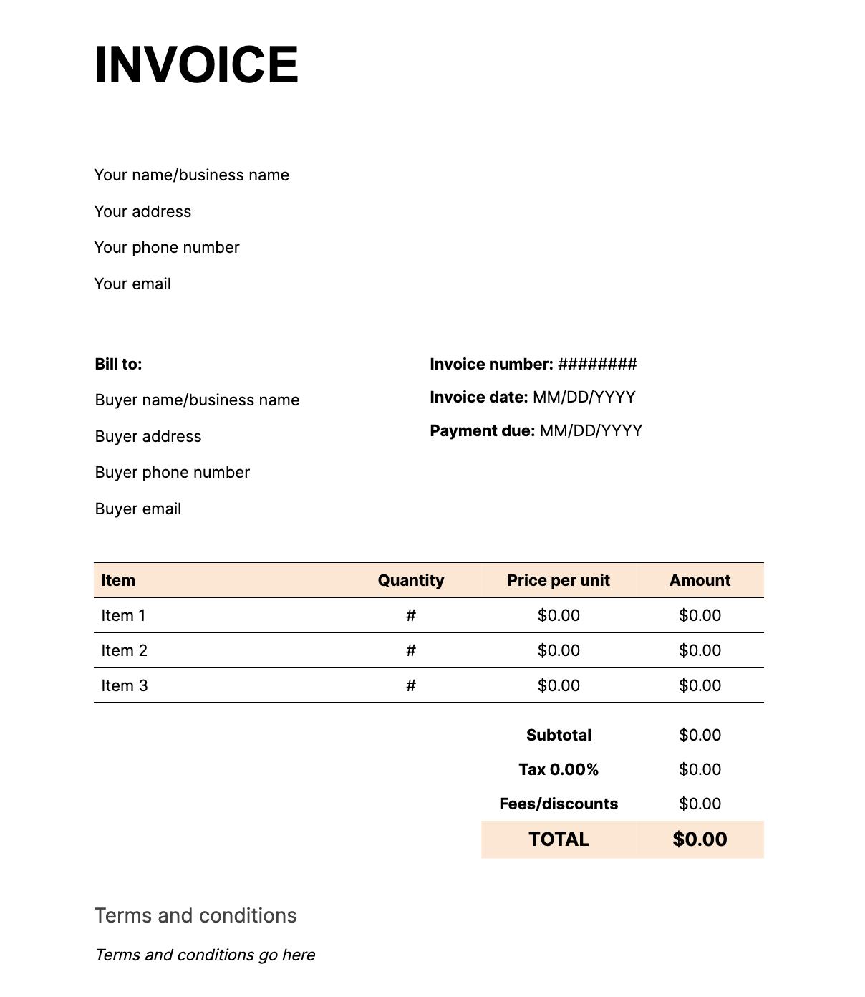
All accounting transactions come from source documents.
Source documents is an accounting terms to describe the original records that contain the details that substantiate the financial transactions that are entered into the internal accounting system of a business
The most common source documents are:
• Invoices
• Credit note
• Receipts,
• Delivery notes,

Slide 13
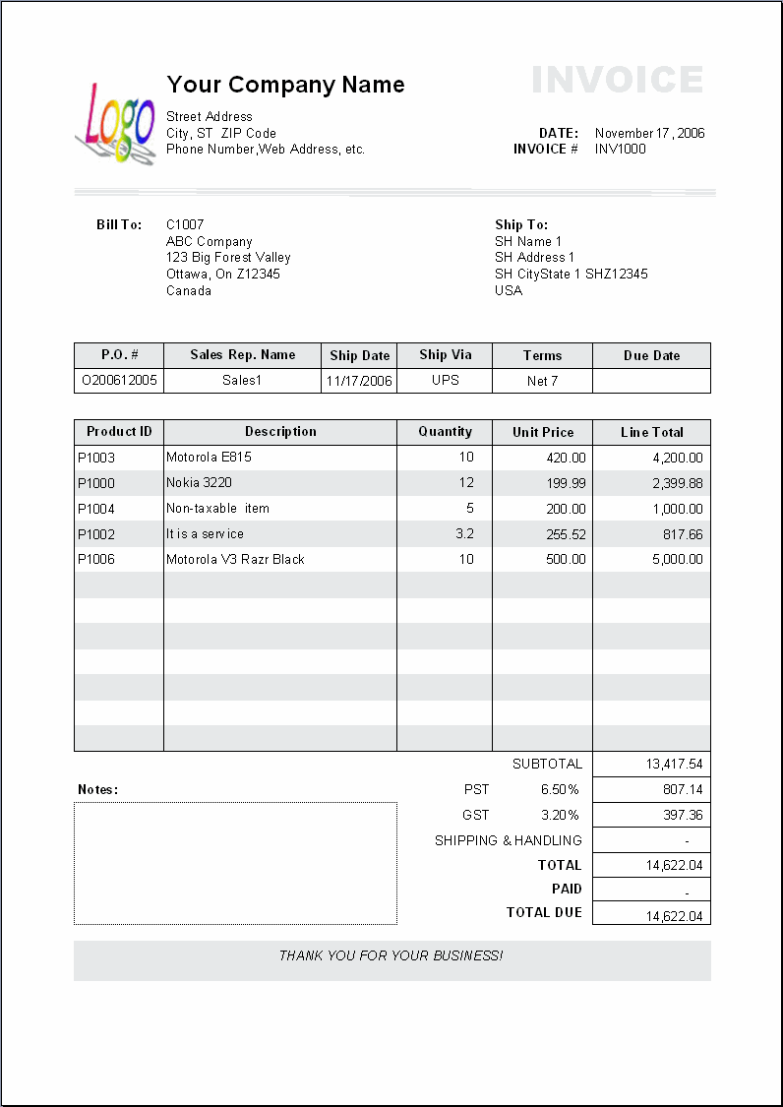
Freight forwarding
Most organisations use freight forwarding services to send their consignments to customers or receive supplies from vendors.
Therefore, freight forwarding is an item that appears in invoices for many companies.

Slide 14
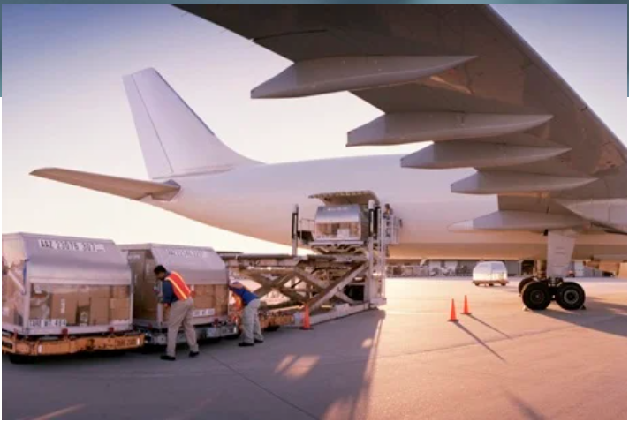
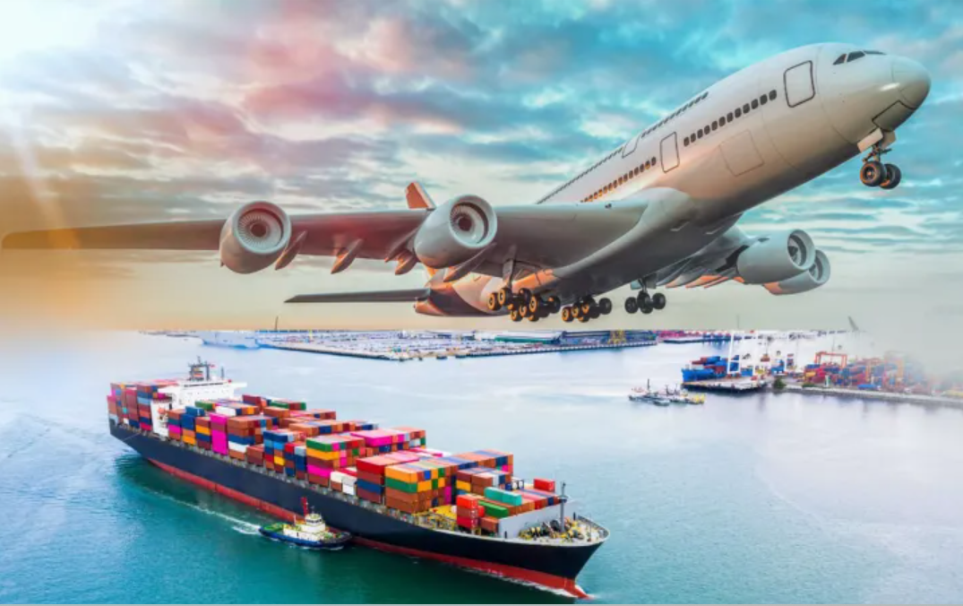
Air freight
Ocean freight

Slide 15
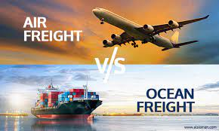
Customs charges
Customs duties
Anti – dumping and countervailing duties
Value Added Tax (VAT)
You buy a pencil for R3 and sell it for R4, you have added value of R1
Price $𝓍$ we x by 15%
The VAT amount on $𝓍$ is simply x (multiplied) by 15 $÷$ 100
= The total VAT is R7,50

Slide 16
Disbursement charges
• Packing
• Fumigation
• Inspection
• Insurance
1. Packing fee
These are charges that are levied by companies that do packaging of cargo to ensure that goods are secured and properly packed in the cargo.
2. Fumigation fee
Some goods must be fumigated before shipment to avoid the spread of pests to other countries.
4. Insurance fee
This is a premium that one pays to an insurance company to safeguard himself against damage, or loss to goods in the cargo.
3. Inspection fee
This is the fee that must be paid for inspectors to check if your goods comply with the legislations of both the exporting country and the importing country.

Slide 17
Formative Assessment
Question 1 (SO 1, AC 1, AC 2)
Using appropriate examples define the following terms;
Expenditure – Pg.8
Revenue – Pg.9
Question 2 (SO 1, AC 3)
In a tabular format, identify the differences between revenue and expenditure – Pg.10 (Draw table)
Question 3 (SO 2, AC 1, AC 2, AC 3): Define the following terms with examples;
Fixed costs – Pg.15
Variable costs – Pg.16
Identify 3 examples of businesses where fixed costs can happen – Pg.15

Slide 18
Question 4 (SO 4, AC 2, AC 3, AC 4, AC 5, AC 6)
Describe the following items that are added to invoices for organisations involved in imports and exports. Pg.31 - 33
• Cartage
• Port authority charges
• Deport charges
• Customs duty
• Carrier handling
Describe the following disbursement charges; Pg.38
• Packaging
• Fumigation
• Inspection
• Insurance
Identify examples of supplementary charges that can be added to invoices for companies involved in import and export business. Pg.39

