Slide 1
Demonstrate an understanding of the principles of the internet and the world-wide-web - 115391

Slide 2
A Brief History of the Internet
Internet, also known as the “World Wide Web”, has changed our lives significantly.
The origin & history of internet date back to 1960s, when developers saw great potential in computers, with regard to sharing information on scientific and military research.
In 1962, J.C.R Licklider proposed a global network of computers and later that year, moved on to Defense Advanced Research Projects to actually develop it.
After sometime, the theory of packet switching was developed by Leonard Kleinrock, which formed the basis of internet connections.

Slide 4
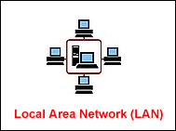
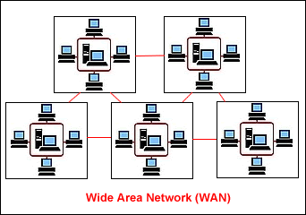
What is the Internet?
The Internet is the largest computer network in the world, connecting millions of computers. A network is a group of two or more computer systems linked together.
•Local Area Network (LAN): A LAN is two or more connected computers sharing certain resources in a relatively small geographic location (the same building, for example).
•Wide Area Network (WAN): A WAN typically consists of 2 or more LANs. The computers are farther apart and are linked by telephone lines, dedicated telephone lines, or radio waves.

Slide 5
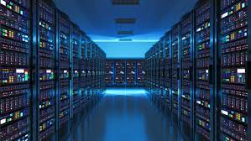
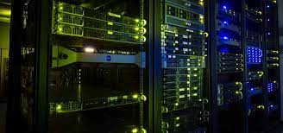
Servers
All computers on the Internet (a wide area network, or WAN) can be lumped into two groups: servers and clients. In a network, clients and servers communicate with one another.
A server is the common source that:
•Provides shared services (for example, network security measures) with other machines
•Manages resources (for example, one printer many people use) in a network.

Slide 6
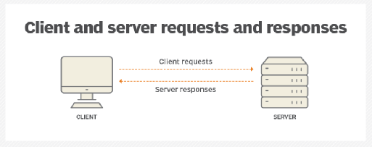
Client server is a relationship in which one program, the client, requests a service or resource from another program , the server

Slide 7
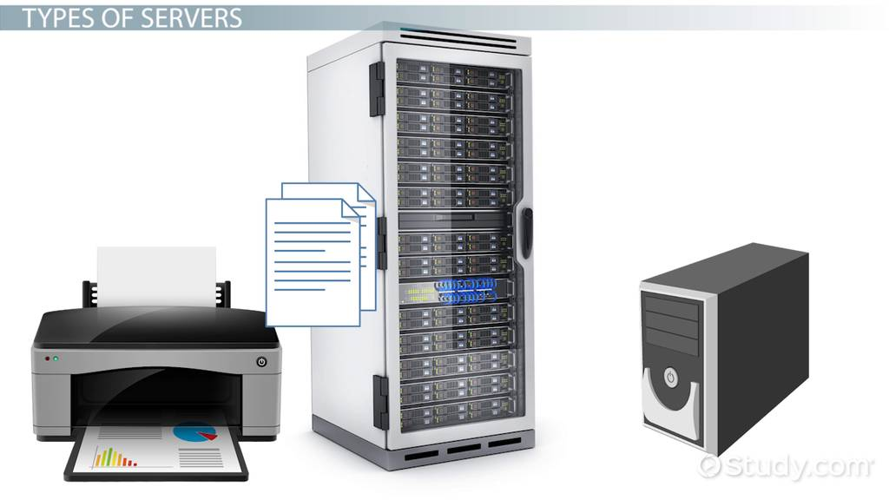
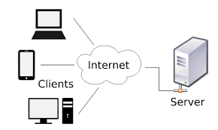
The term server is often used to describe the hardware (computer), but the term also refers to the software (application) running on the computer.
Many servers are dedicated, meaning they only perform specific tasks.

Slide 8
Clients
Remember, all computers on the Internet (a wide area network, or WAN) can be lumped into two groups: servers and clients, which communicate with one another.
Independent computers connected to a server are called clients. Most likely, your home or office computer does not provide services to other computers. Therefore, it is a client.
Clients run multiple client software applications that perform specific functions.
For example,
•An email application such as Microsoft Outlook is client software.
•Your web browser (such as Internet Explorer or Netscape) is client software.

Slide 9
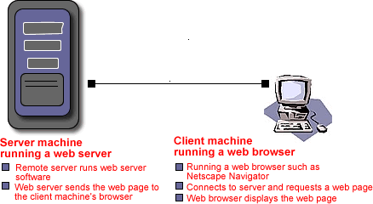
Servers and Clients Communicate
•Your computer (client hardware) is running a web browser such as Internet Explorer (client software).
•When you want to surf the web, your browser connects to a remote server and requests a web page.
•The remote server (server hardware) runs web server software (server software).
•The web server sends the web page to your computer's web browser.
•Your web browser displays the page.

Slide 10
The World Wide Web (WWW)
This menu-based system, which was originally envisioned as an internal document-management system, now organizes Internet resources throughout the world into a series of hypertext-linked menu pages.
Internet is global connection of networks while the Web is a collection of information. Internet is the infrastructure while the web is a service on top of it

Slide 12
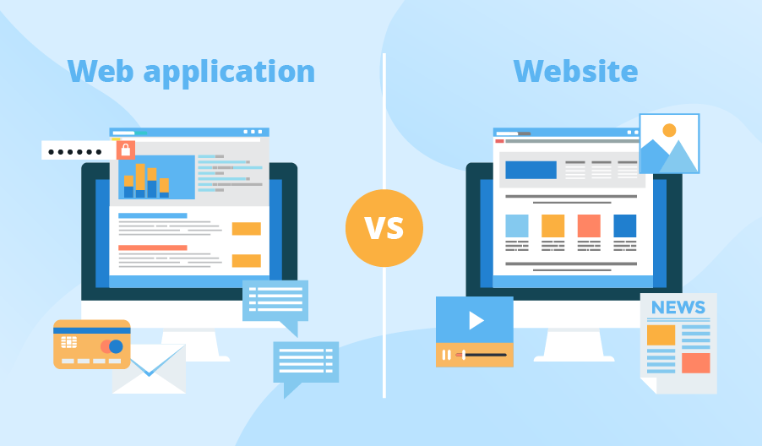
Internet and Web Applications
The Internet has enabled a variety of technologies and services to emerge. Some of these are discussed in the following sections.
•Business Uses of the Web: In 1991, the Commercial Internet Exchange (CIX) Association was established to allow businesses to connect to the Internet.
•E-Mail, Instant Messaging, and Push Technology: E-mail messages need not consist of simple text messages
•Internet Cell Phones and Handheld Computers: Increasingly, cell phones, handheld computers, and other devices are being connected to the Internet.

Slide 13
•Career Information and Job Searching: The Internet is an excellent source of job-related information
•Telnet and FTP: Telnet is a terminal emulation protocol that enables you to log on to other computers on the Internet to gain access to their publicly available files.
•Web Log (Blog), Video Log (Vlog), and Podcasting: A Web log, also called a blog, is a Web site that people can create and use to write about their observations, experiences, and feelings on a wide range of topics.
•Usenet and Newsgroups: Usenet is an older technology that uses e-mail to provide a centralized news service.

Slide 14
•Chat Rooms: A chat room is a facility that enables two or more people to engage in interactive “conversations” over the Internet.
•Content Streaming: Content streaming is a method for transferring multimedia files, radio broadcasts, and other content over the Internet so that the data stream of voice and pictures plays more or less continuously, without a break, or with very few breaks.
•Shopping on the Web: You can shop for almost anything over the Internet, including books, clothes, cars, computers, medications, etc.
•Web Auctions: A Web auction is a way to connect buyers and sellers.
•Music, Radio, Video, and TV on the Internet: Music, radio, and video are hot growth areas on the Internet

Slide 15
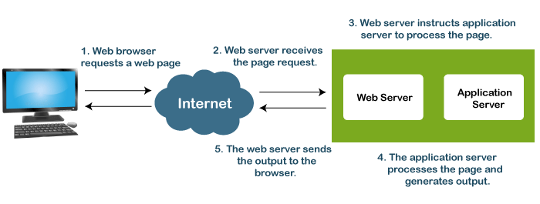
•Office on the Web: An Internet office is a Web site that contains a person’s files, phone numbers, e-mail addresses, an appointment calendar, and more.
•Internet Sites in Three Dimensions: Some Web sites offer three-dimensional views of places and products.
•Other Internet Services and Applications: Other Internet services are constantly emerging.

Slide 16
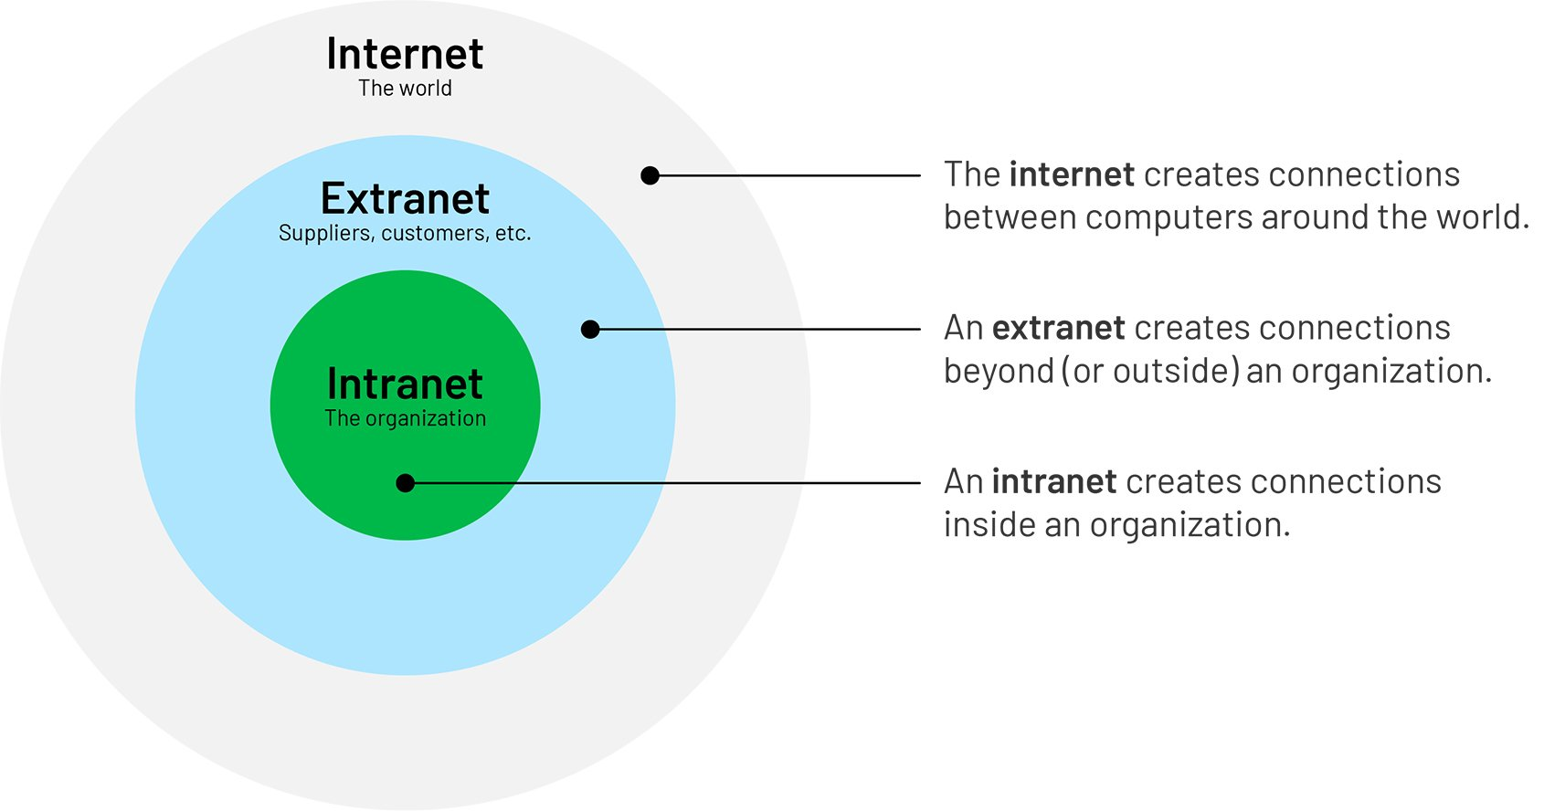
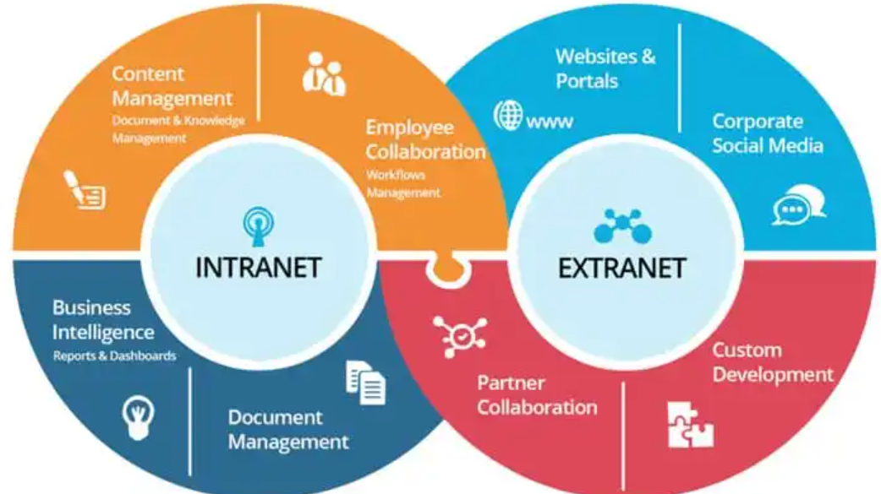
Application of World-Wide Web in intranet and extranet
•An intranet is an internal corporate network built using Internet and World Wide Web standards and products. Employees of an organisation use it to gain access to corporate information
•An extranet extends selected resources of an intranet out to a group of its customers, suppliers, or other business partners. Like an intranet, it is based on Web technologies; however, its security and performance concerns are different.

Slide 17
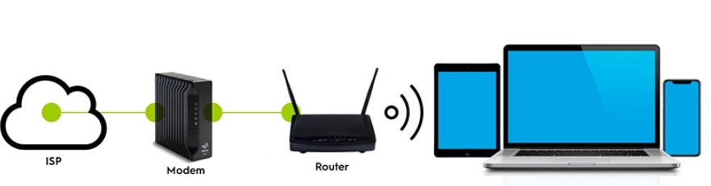
Modems, Browsers and ISPs
What is a modem?
•A modem is a device that converts a computer's outgoing data to a format that can be transferred via telephone lines. Modems can also convert incoming data so the computer can read it.
What is a web browser?
•Remember, along with a computer equipped with a modem, you need a piece of software called a web browser to navigate the Web.

Slide 18
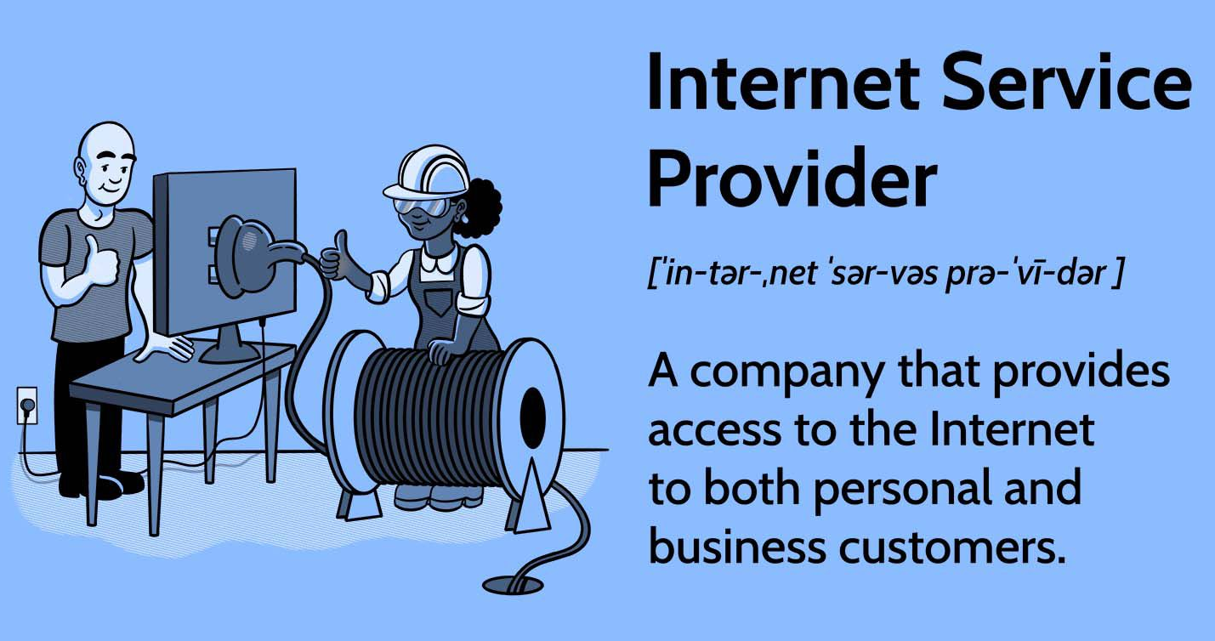
Internet Service Providers
To access the Internet, you need a computer equipped with a modem and web browser, but you'll also need an ISP.
Internet Service Providers (ISPs) are companies that provide access to the Internet.
In South Africa, Telkom SA, Vodacom, MTN, Afrihost, Cool Ideas, and Web Africa

Slide 19
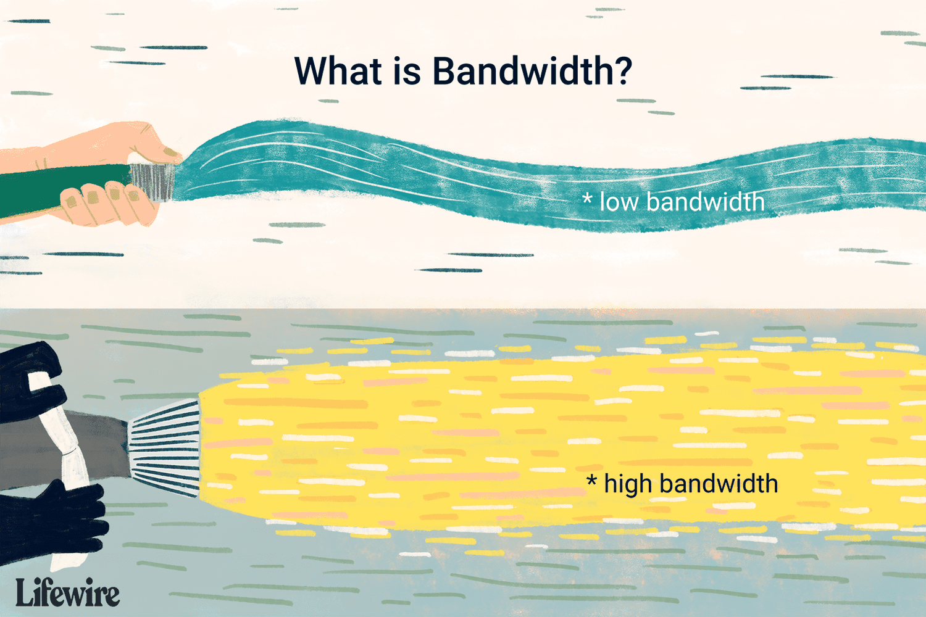
Bandwidth - The Need for Speed
If you surf the Web frequently, you are probably used to waiting, and waiting, and waiting some more.
Slow Internet access means some users are unable to access certain web pages, especially those loaded with graphics, sound, and video. So, to access the latest web technologies, users need more speed.
A fast modem doesn't ensure fast transmission rates. Fast data transmission often depends on bandwidth.
Bandwidth is the amount of data actually being sent through a network circuit.

Slide 20
Types of Internet Access
ISDN (Integrated Services Digital Network)
Faster than 56K dial-up, but every ISP does not support ISDN.
DSL (Digital Subscriber Line)
Newer technologies such as DSL use an ISP to connect to the Internet and allow faster connections.
Cable Modem
Cable modems, another newer technology that uses an ISP to connect to the Internet, allows faster connections.

